Slide 1
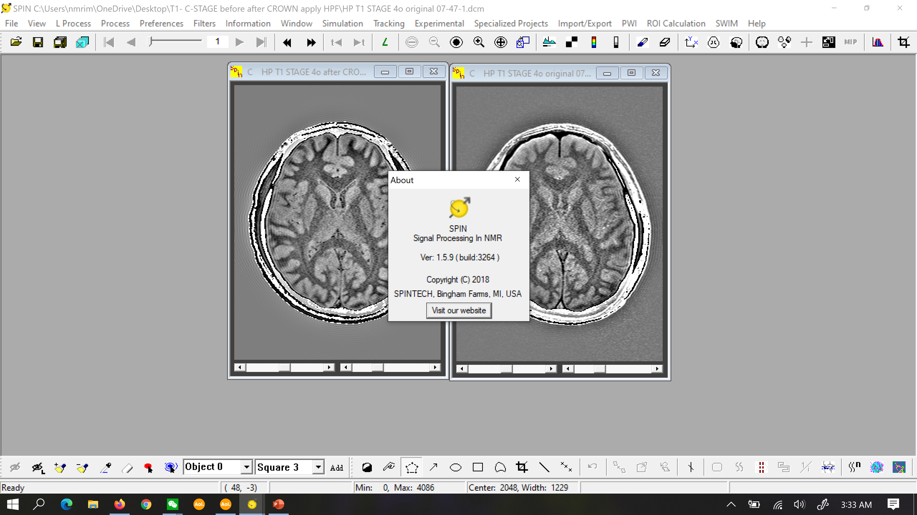
MAGNETIC RESONANCE IMAGING:
SPINS, SPINS and yet more SPINS
E. Mark Haacke, Ph.D.
Ruijin Hospital, SJTU, SOM
Wayne State University
Detroit, Michigan, USA

Slide 2
IMAGING PROTONS WITH MRI
Protons are spin ½ particles.
This means that when you put a proton in a magnetic field it will either be parallel to or anti-parallel to the main magnetic field.

Slide 3
IMAGING PROTONS WITH MRI
Spin-1/2 state: its
up or down
B_{o}
0
0
1
In this schematic, there is only 1 excess spin that is parallel to the main field B_{o}.

Slide 4
SPIN EXCESS: WHY MRI IS A VERY INEFFICIENT IMAGING MODALITY
5 x 10⁵
-5 x 10⁵
only 1 in 10⁶ spins remains pointing up
B_{o} = 0.15T
In this schematic, there is only 1 excess spin that is parallel to the main field B_{o}.

Slide 5
SPIN EXCESS AT 1.5T
B_{o} = 1.5T
Now there are 10 excess spins parallel to the main field B_{o}.

Slide 6
SPIN EXCESS DEPENDS ON MAGNETIC FIELD
=
M
Each spin has its own magnetic moment.
M = bulk magnetization
10²⁶ in the human brain (1.5L) so the spin excess is 10²¹

Slide 7
MRI FREQUENCEY DEPENDENCE ON FIELD:
THE LARMOR EQUATION
ω = γB_{o}
This equation has the simplest possible mathematical form a = bc and much of MRI can be understand from its implications.

Slide 8
WHAT IS FREQUENCY
ω = γB_{o}
Angular frequency is the rate of rotation around an axis of rotation in radians per second (or in degrees per second).
ω = 2πf
Frequency is the rate of rotation around an axis of rotation in cycles per second.

Slide 9
WHAT IS PHASE
φ = ωt = γB_{o}t
Angular frequency is the rate of rotation around an axis of rotation in radians per second (or in degrees per second).
φ = 2πft = 2πγ B_{o}t where
γ = γ/2π
Frequency is the rate of rotation around an axis of rotation in cycles per second.

Slide 10
WHAT IS PHASE
f = γB_{o}
γ = γ/2π = 42.6 MHz/T
at 1T: f = 42.6 MHz
at 1.5T: f = 64 MHz
at 3T: f = 128 MHz
at 5T: f = 213 MHz
at 7T: f = 300 MHz
at 9.4T: f = 400 MHz
at 11.7T: f = 500 MHz

Slide 11
ANGULAR DISTANCE = PHASE
Consider the simple process of walking along a sidewalk straight.
What distance (d) have you walked in a time t?
d = vt
In the same way, phase or “angular distance” is
φ = ωt

Slide 12
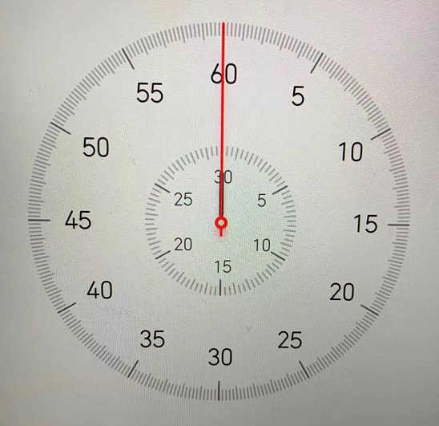
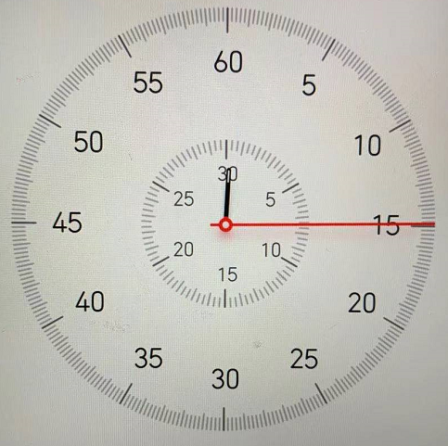
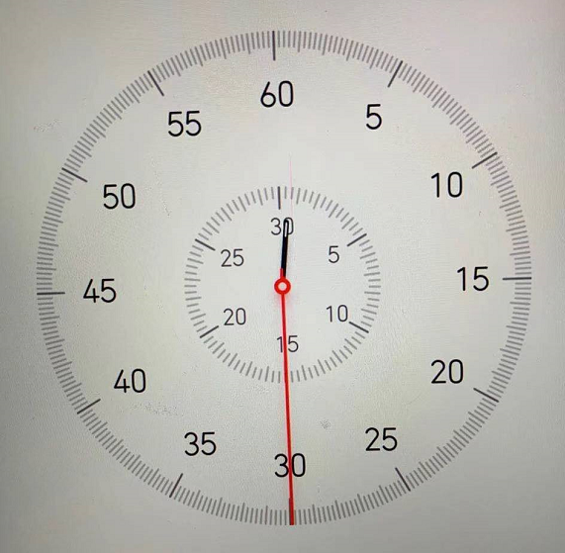
ANGULAR DISTANCE = PHASE
φ = ωt
ω = 360º per minute or
ω = 2π radians per minute
φ₀
φ₁
φ₂
LHS
φ₀ = 0
φ₁ = 90º or π/2
φ₁ = 180º or π

Slide 13
ANGULAR DISTANCE = PHASE
φ = ωt
ω = 360º per minute or
ω = 2π radians per minute
φ₀
φ₁
φ₂
RHS
φ₀ = 0
φ₁ = -90º or -π/2
φ₁ = -180º or -π

Slide 14
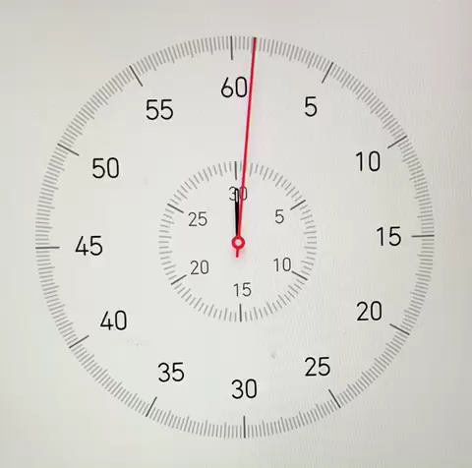
ANGULAR DISTANCE = PHASE
For a left handed system clockwise is positive

Slide 15

LEFT HANDED
y
z
x
side view
top view

Slide 16

RIGHT HANDED
y
z
x
side view
top view

Slide 17
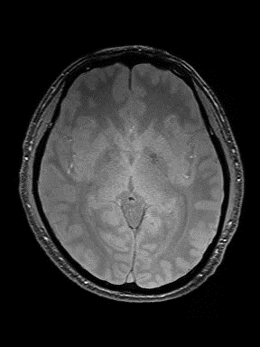
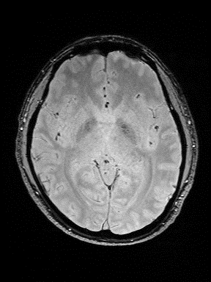
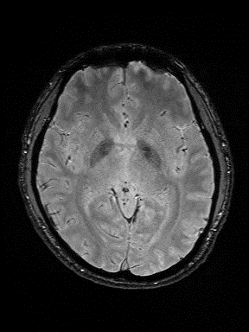
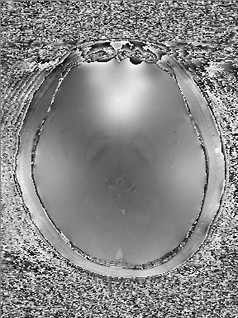
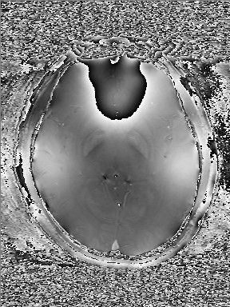
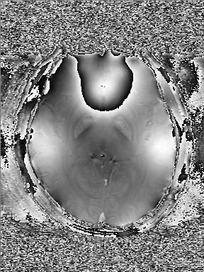
AS ECHO TIME CHANGES PHASE CHANGES:
φ = ωTE
6°TE=7.5ms
6°TE=15ms
6°TE=22.5ms
Magnitude
Phase

Slide 18
ANGULAR DISTANCE = PHASE
φ = 2πft with f = 1/6 cps

Slide 19
ANGULAR DISTANCE = PHASE
φ = ωt
ω = 360º per minute or
ω = 2π radians per minute
φ₀
φ₁
φ₂
RHS
φ₀ = 0
φ₁ = -90º or -π/2
φ₁ = -180º or -π

Slide 20
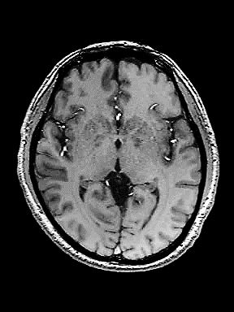
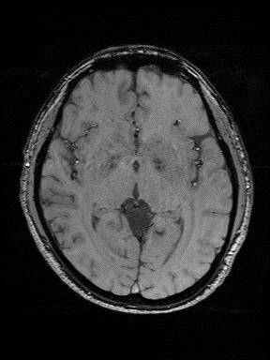
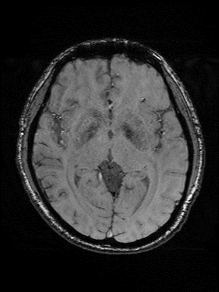
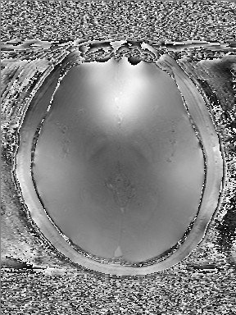
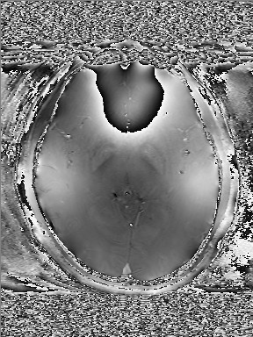
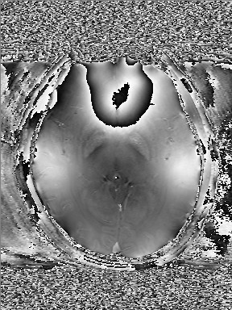
AS ECHO TIME CHANGES PHASE CHANGES:
φ = ωTE
27°TE=7.5ms
27°TE=15ms
27°TE=22.5ms
Magnitude
Phase

Slide 21


Size of the magnitude vector does not affect the phase
_{z}
$$φ$$
y
x
Note that the phase $φ$does not depend on the magnitude of the vector, whether the yellow one or green longer one, they have the same phase.

Slide 22
AS ECHO TIME CHANGES PHASE CHANGES:
Two flip angles give the same phase image,
despite having totally different signals at each pixel.
TE=7.5ms
TE=15ms
TE=22.5ms
Phase 6º
Phase 27º

Slide 23
SUMMARY
Spin excess depends on field strength.
The higher the field the bigger the magnetization.
The higher the field the faster the spins precess.
The handedness does not change the physical rotation of the spins only the sign that you assign it.
Phase depends on magnetic field not the image magnitude.

Slide 24
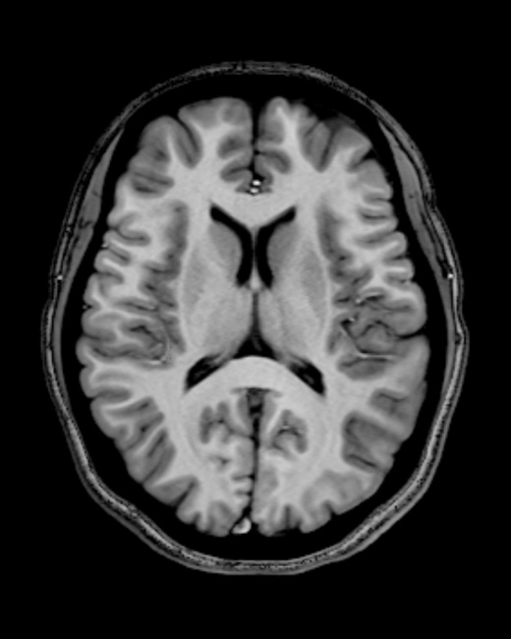
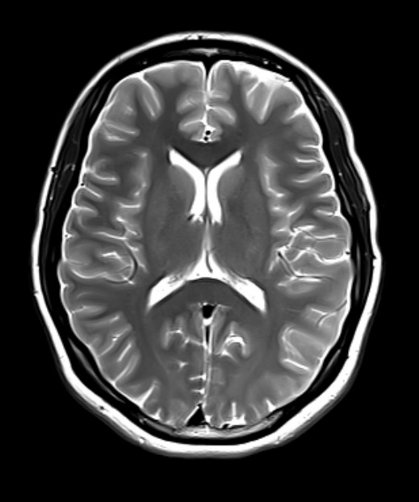
Pause

