Slide 1

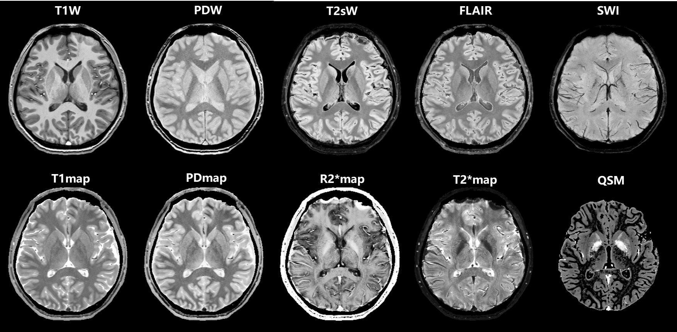
SPIRIT
Signal Processing in Rapid Imaging Technology
Fast, quantitative, standardized 3D thin slice, whole brain imaging
Total scan time 2~5 minutes for 10 image types
Quantitative
T1 Map
PD Map
R2*, T2* Maps
QSM
Qualitative
T1W
PDW
T2sW, SWI
FLAIR
Available for research applications on 3T scanners.
Images are B1 transmit and B1 receive corrected for all coils and field strengths giving uniform optimized T1 contrast.
For more information contact Dr. Wu Bo at wubomrisci@163.com or phone:13823319432

Slide 2
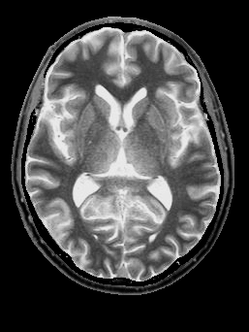
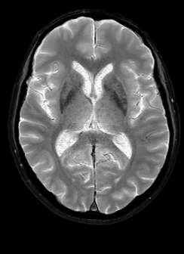
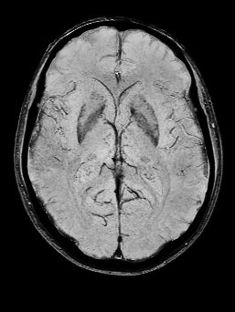
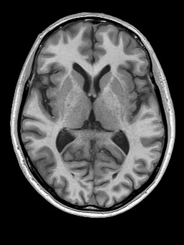
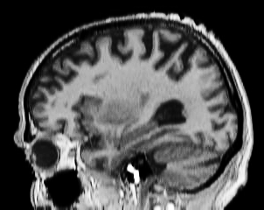
Unparalleled rapid multi-contrast imaging with SPIRIT
Offering 2-5 Minute Whole Brain Rapid Quantitative Imaging
These provide clinical output with full 3D thin slice data or an average of two adjacent slices to increase SNR and also reduce the number of images to a more realistic number for radiologic assessment.
PSD
T2*W
SWI
T1W
T1W
Resolution: 0.67mm x 1mm x 2mm:
Images acquired on a Philips Elition scanner
SPIRIT images can now be collected with 2mm slice thickness in just 2-5 minutes and the resulting images can be output using Philips PRIDE interface software linked to third party vendors.
For more information contact Dr. Wu Bo at wubomrisci@163.com or phone:13823319432

Slide 3
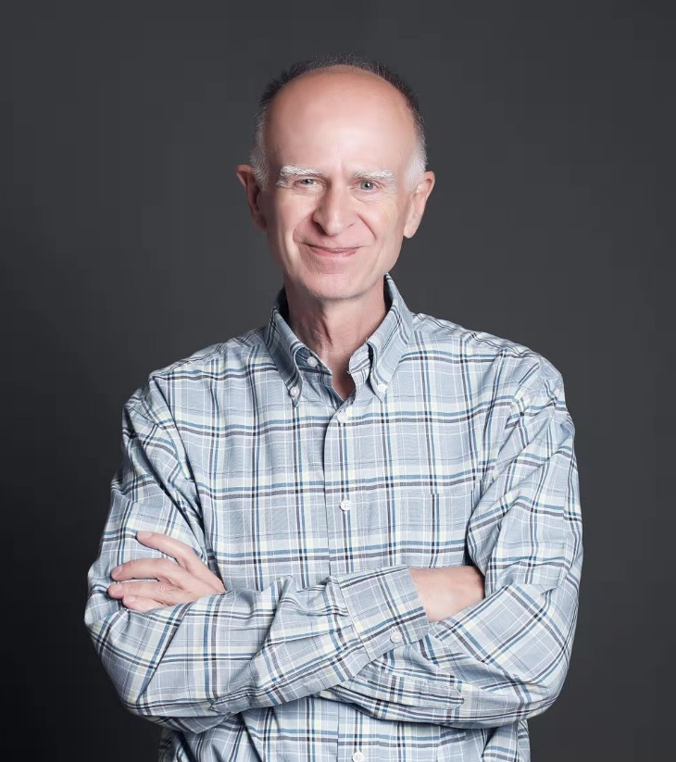
Shanghai Zhuying Ltd.
Prof. Haacke’s background and acomplishments
Prof. E. Mark Haacke, PhD, Inventor: MRA, SWI, SPIRIT
President and CSO of Shanghai Zhuying Ltd.
Professor E. Mark Haacke, PhD
Affiliated with both Wayne State University and Ruijin Hospital, SJTU in Shanghai
Prof. Haacke has been in the field of MRI since 1983.
Pioneered technologies such as super-resolution image reconstruction, fast imaging, MR angiography, Susceptibility Weighted Imaging (SWI), Quantitative Susceptibility Mapping (QSM) and. more recently. STrategically Acquired Gradient Echo (STAGE) with SPIRIT processing.
Past President of the ISMRM, SMRI and ISNVD.
Recipient of the Gold and Silver Medals of the ISMRM and the Gold Medal of the ISNVD
Trained and mentored more than 150 students, post-docs, fellows and junior faculty.
Published more than 500 papers, patents, and other articles, with 55,000+ citations and an h-factor of 109.

