Slide 1
Noise, CNR and relative CNR:
How to prepare for reporting CNR in your publications
A brief introduction
E. Mark Haacke, PhD
Wayne State University
Ruijin SJTU School of Medicine

Slide 2
There are 4 ways you can find some type of contrast or contrast-to-noise measure.
1) Contrast = S1 – S2
2) Actual contrast-to-noise = CNR = (S1 – S2)/σ_{o} where σ_{o} is the same for all data sets.
3) Relative or normalized contrast C_{rel} = (S1-S2)/S1
4) Alternate normalized contrast-to-noise CNR_{relalt}= (S1 – S2)/σ_{S2}
How do we find the noise?
If we draw an ROI in the original image then we must draw it in a uniform region
that is there can be no variability of the signal spatially as it corrupts σ_{o} .
The easiest way is to just collect the data twice and subtract S1-S1’. This gives sqrt(2)σ_{o} .
Or from 3 echo data use ΔS = S(TE2)-avgS(TE1,TE3). This gives sqrt(1.5)σ_{o} .
So from either of these measurements divide by either sqrt(2) or sqrt(1.5).

Slide 3
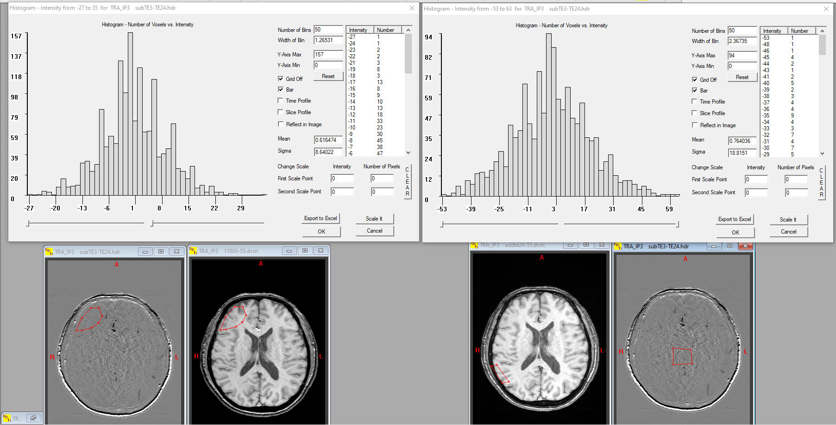
Subtracting data from the same scan acquired twice
Noise on the left at the edge of the brain is 8.6 units and noise for the middle of the brain is 18.8 units roughly double that at the edge (due to parallel imaging and distance from the coils). As expected that the average is close to zero! But these are not σ_{o} but sqrt(2)σ_{o} .

Slide 4
Subtracting data from the same scan acquired twice
The true estimate of noise on the left at the edge of the brain is 8.6/sqrt(2) = 6.1 units.
The true estimate of the noise for the middle of the brain is 18.8/sqrt(2) = 13.3.

Slide 5
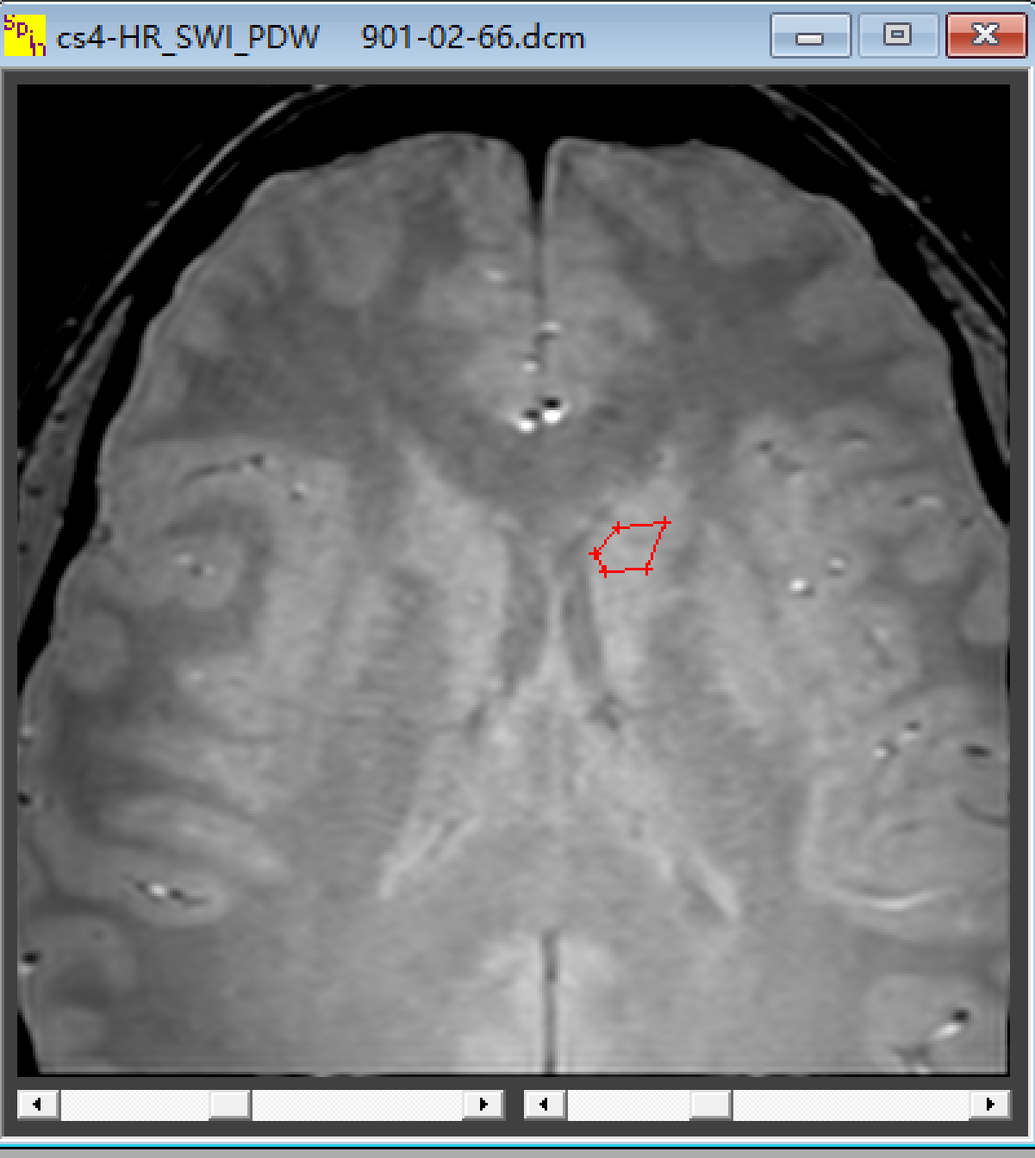
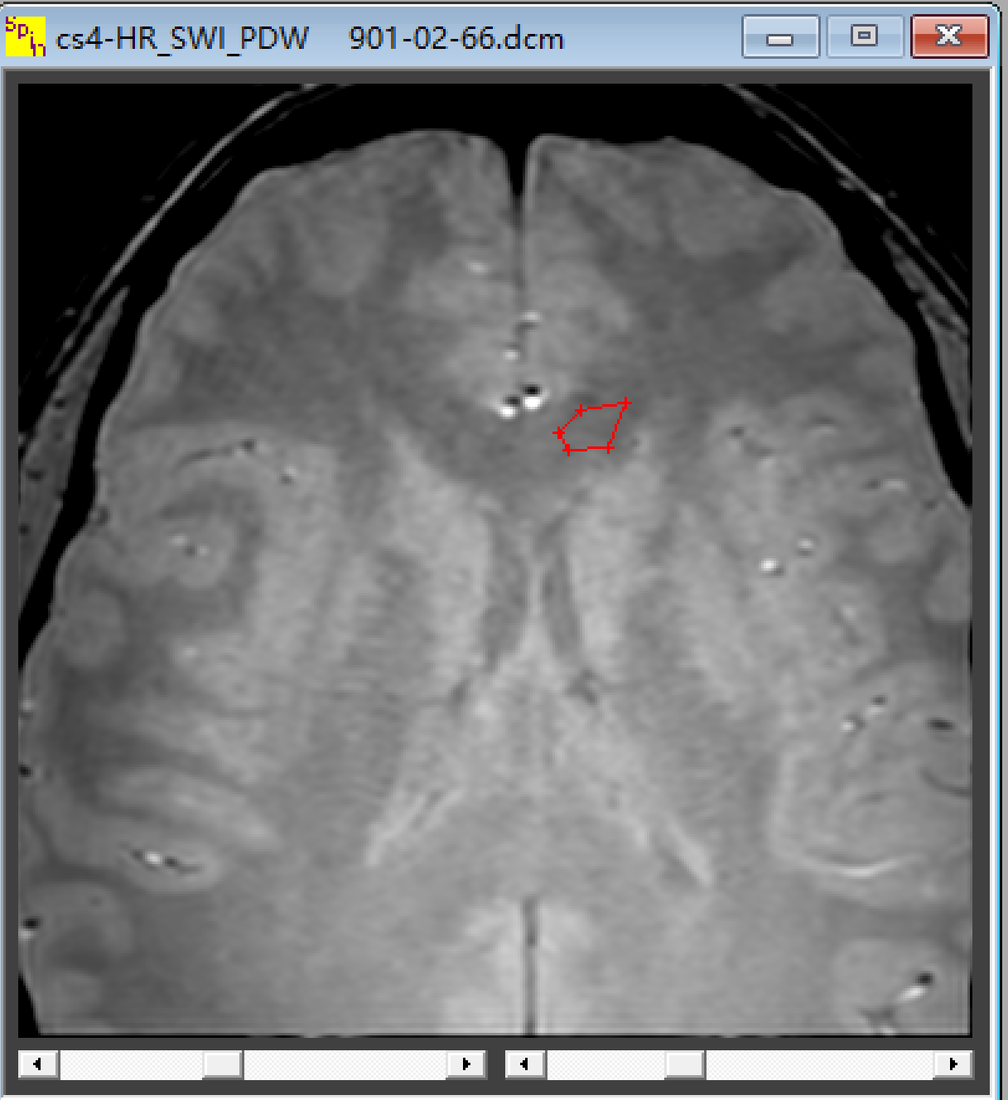
Resolution: 0.67×1×3mm³
Scan time : 1min 38s
PSDW
Contrast= S1-S2
Relative Contrast= (S1-S2)/S2
S2
S1
To be able to clearly find a change in contrast algorithmically requires a difference in signal of roughly 4 standard deviations that is CNR > 4:1.

Slide 6
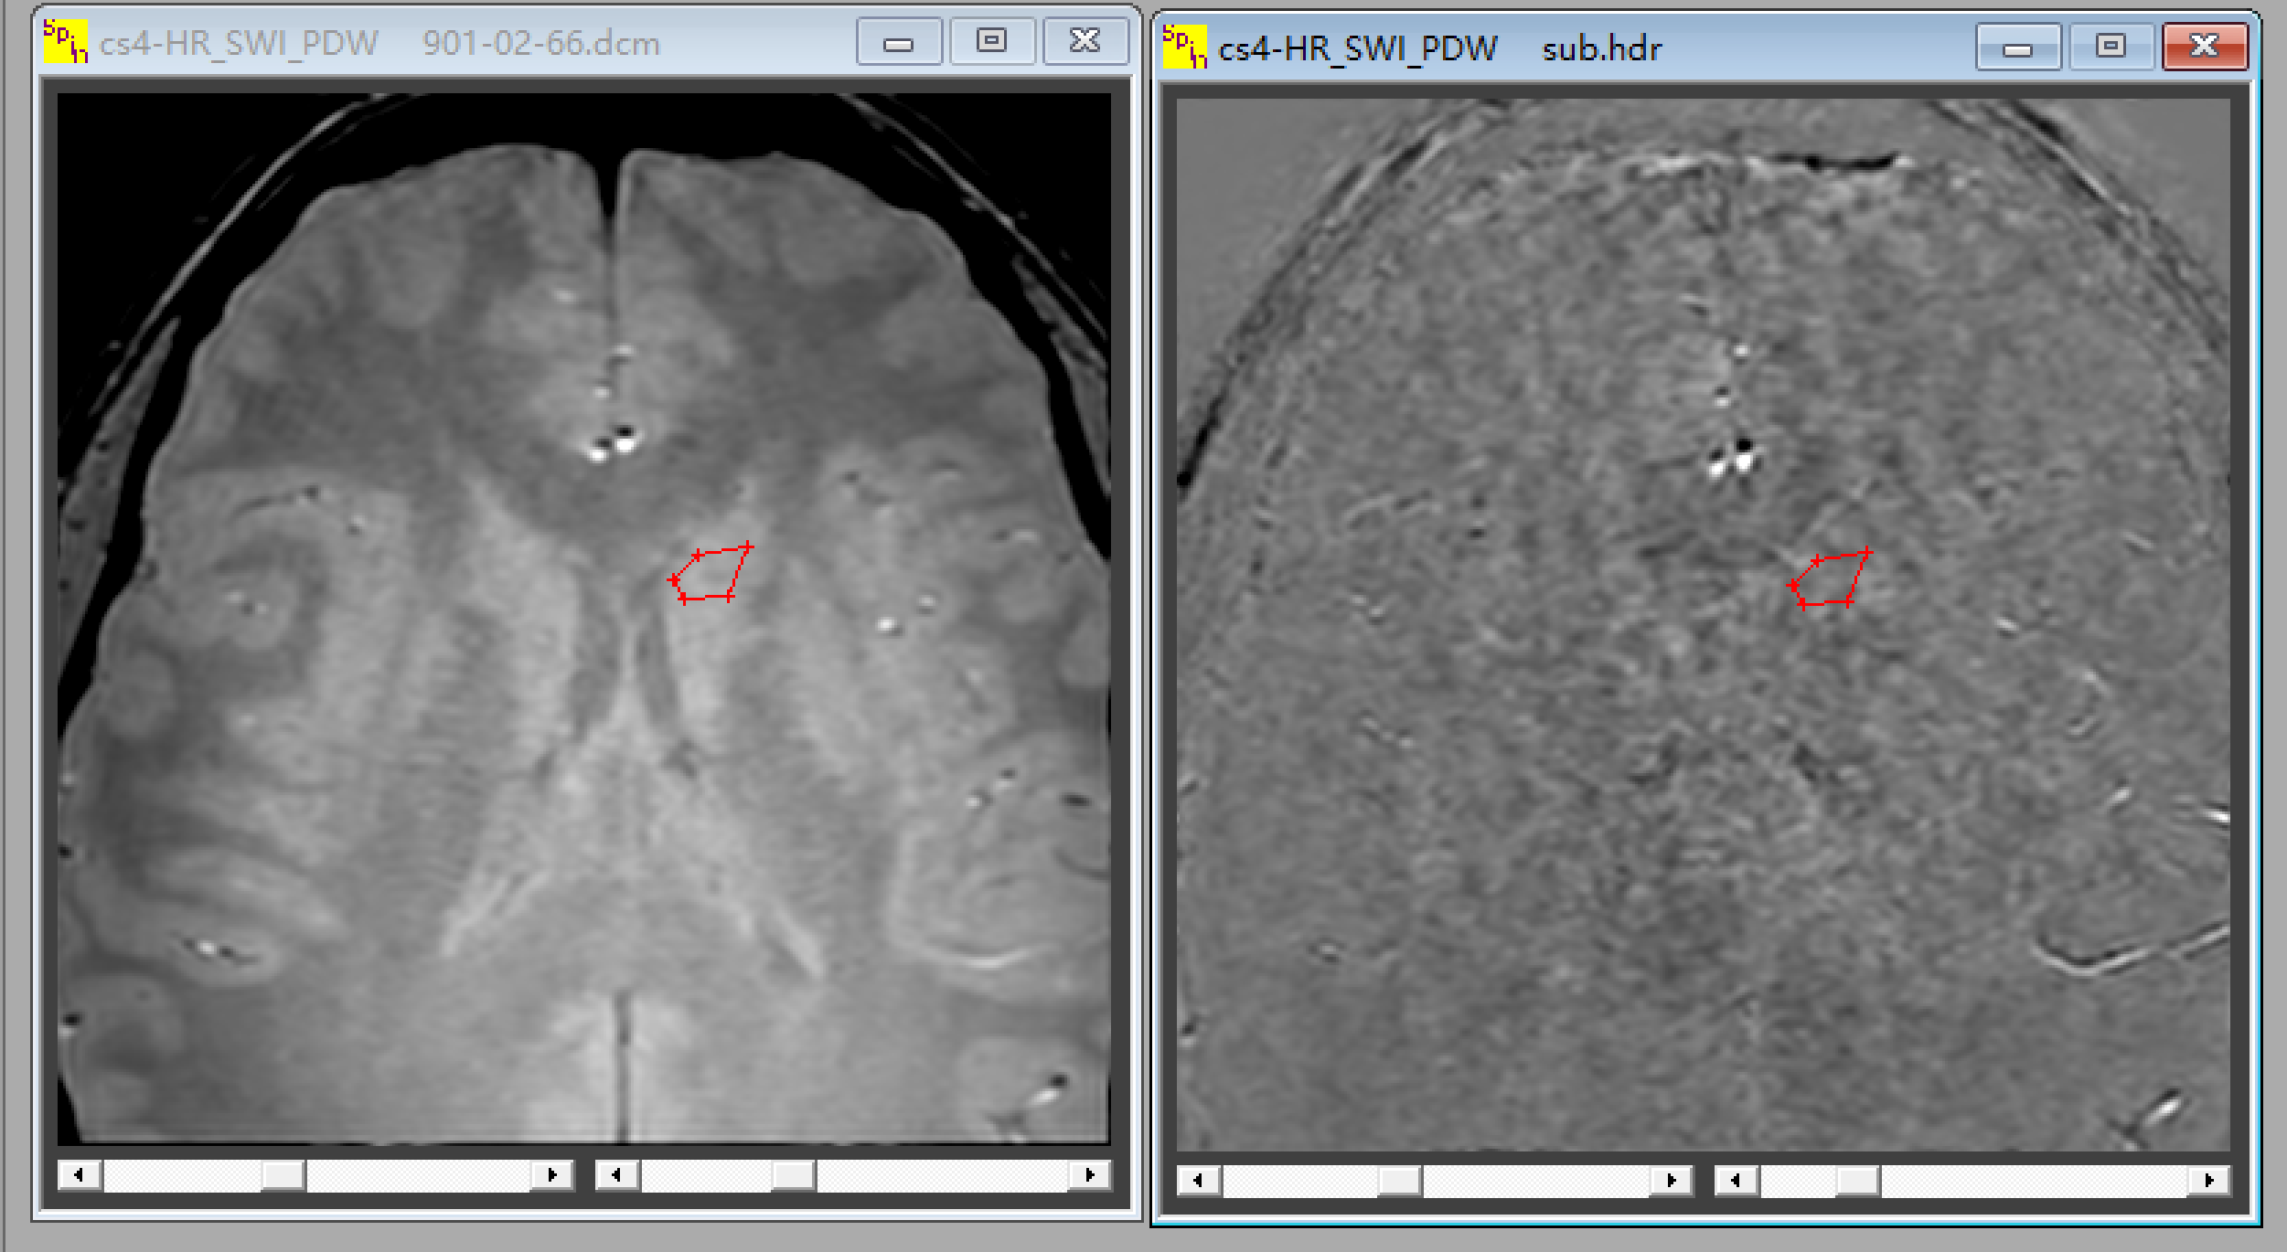
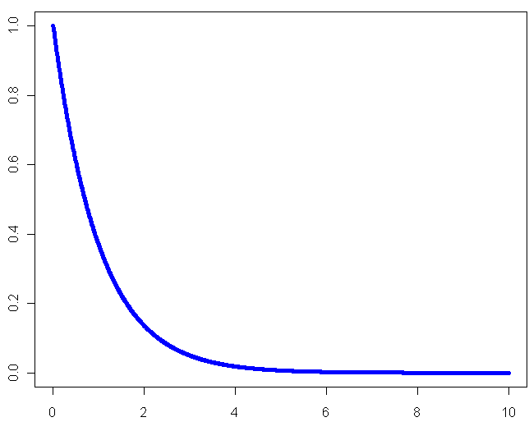
ΔS = S(TE2)-avgS(TE1,TE3)
Note the boundaries between tissues are all gone in the subtracted image showing that the noise is the same for all tissues.
S(TE1)
S(TE2) = 0.5(S(TE1+S(TE3))
S(TE3)
Remember also that the measurement of noise has noise!
So you could measure noise in say 10-30 cases and get the mean of the noise which you would then use for all subjects.

Slide 7
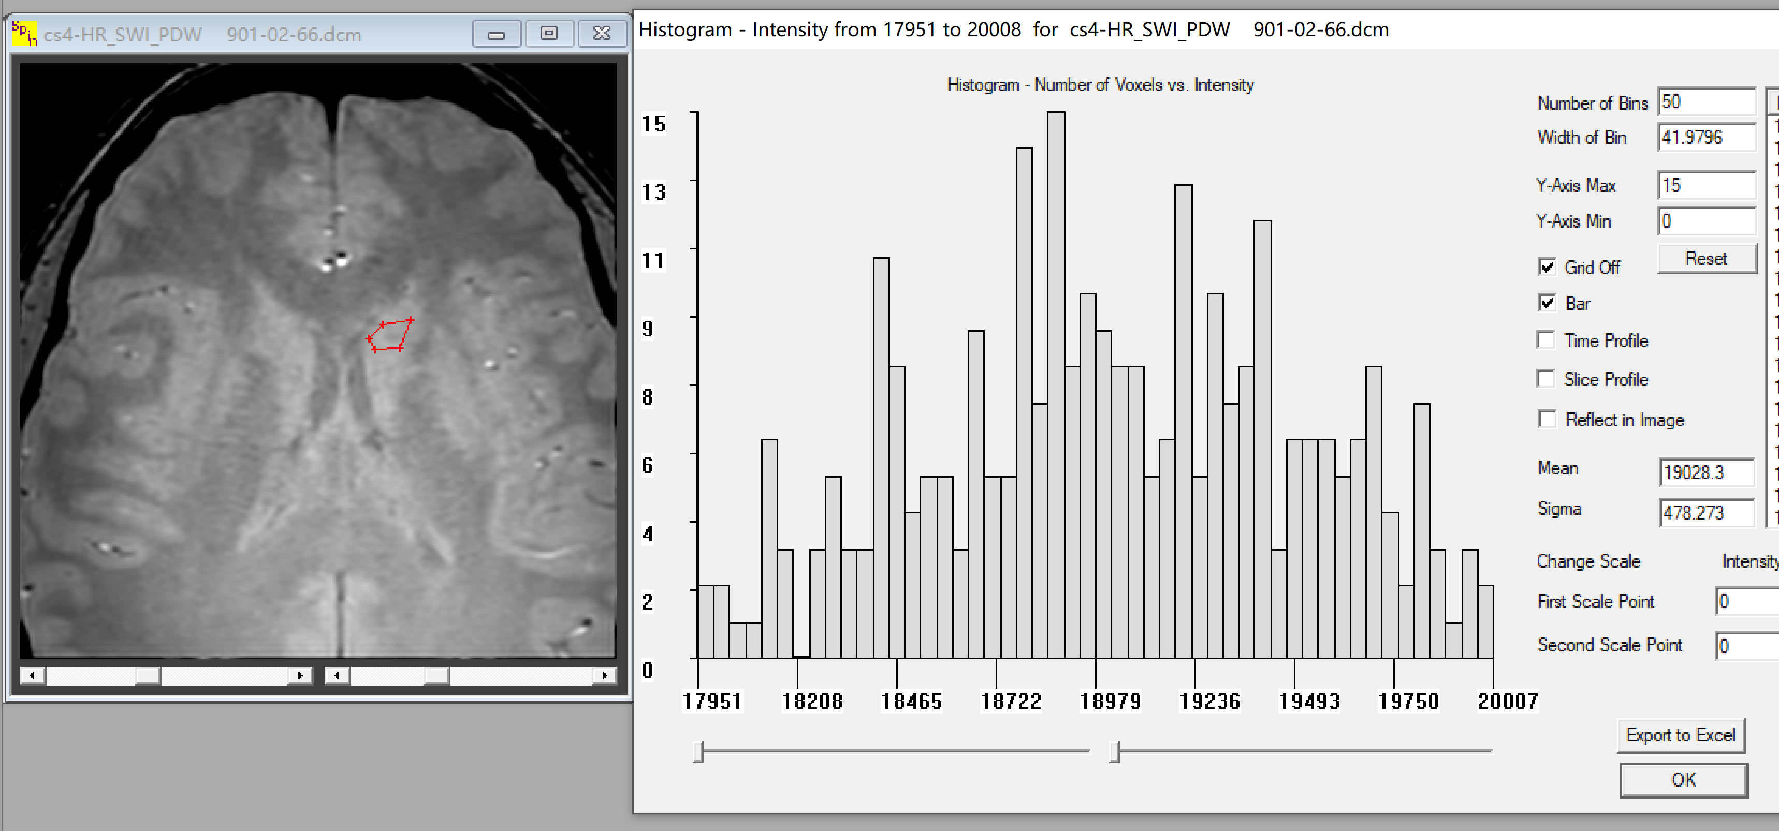
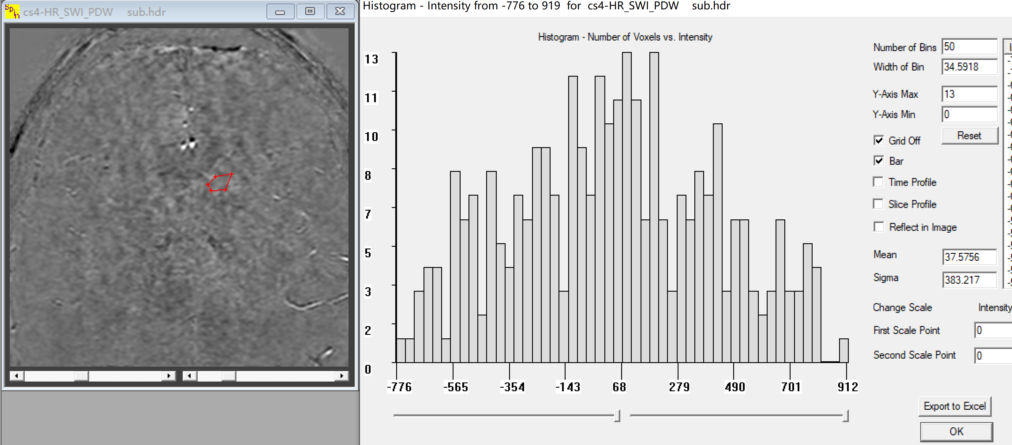
Note the error here is 478 units.
Note the error here is 383 units which is sqrt(1.5) σ_{o} .
So the correct noise to quote is 383/sqrt(1.5) = 312 which is clearly much smaller than 478.

Slide 8
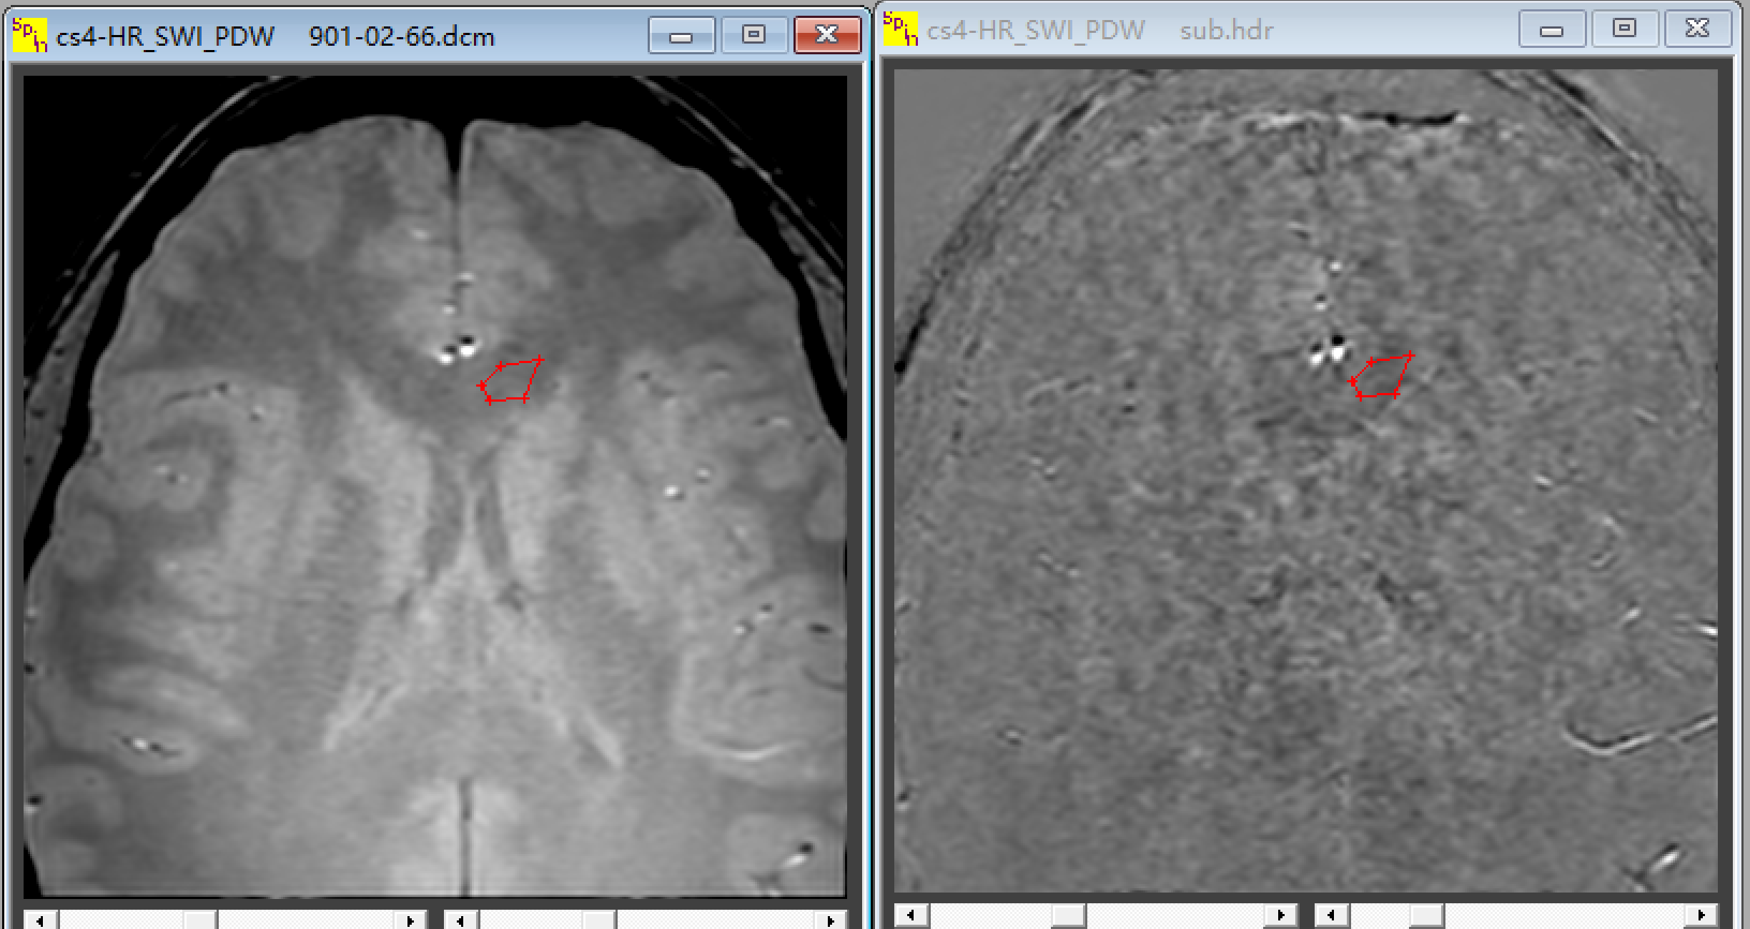
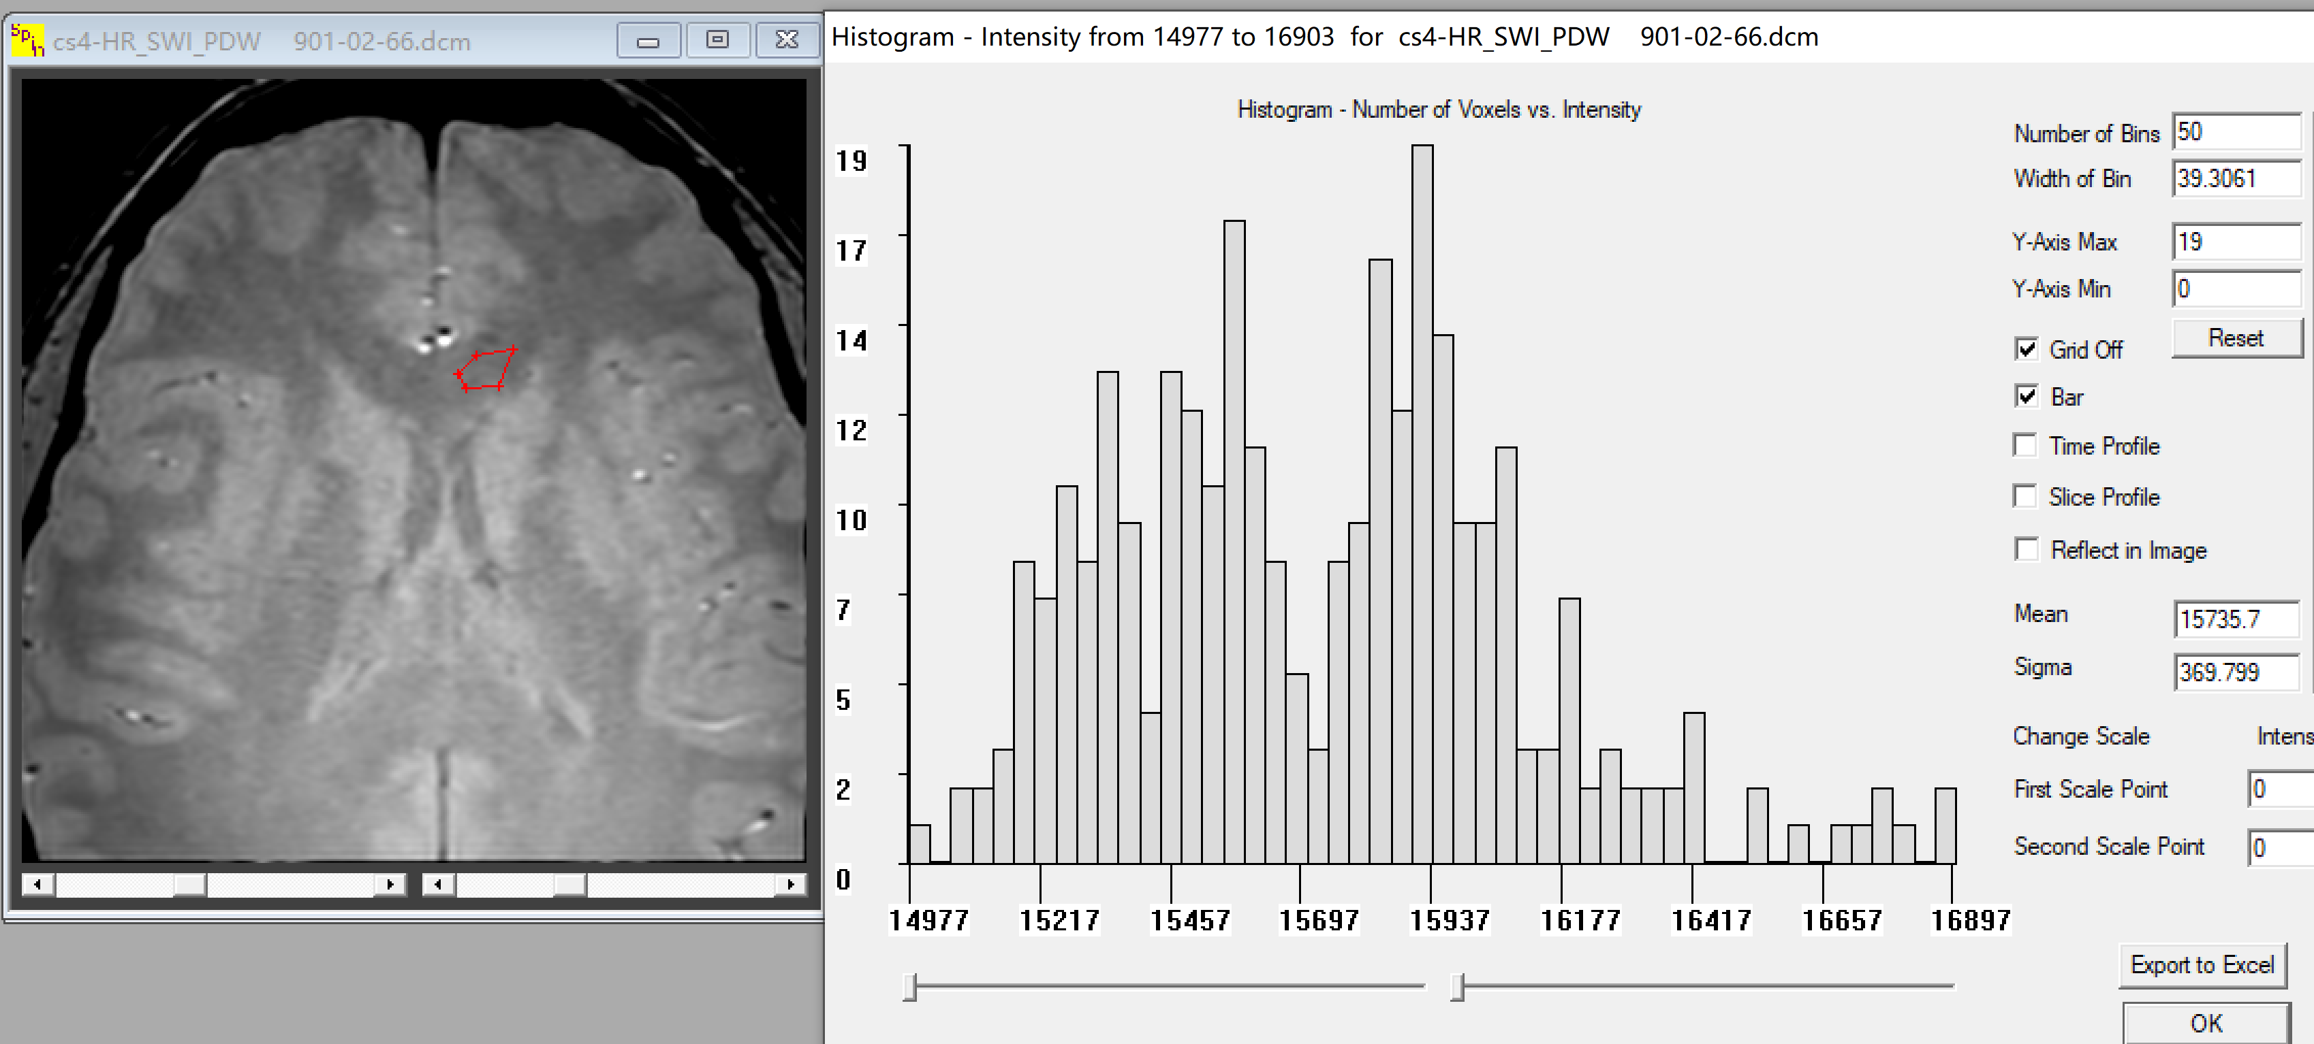
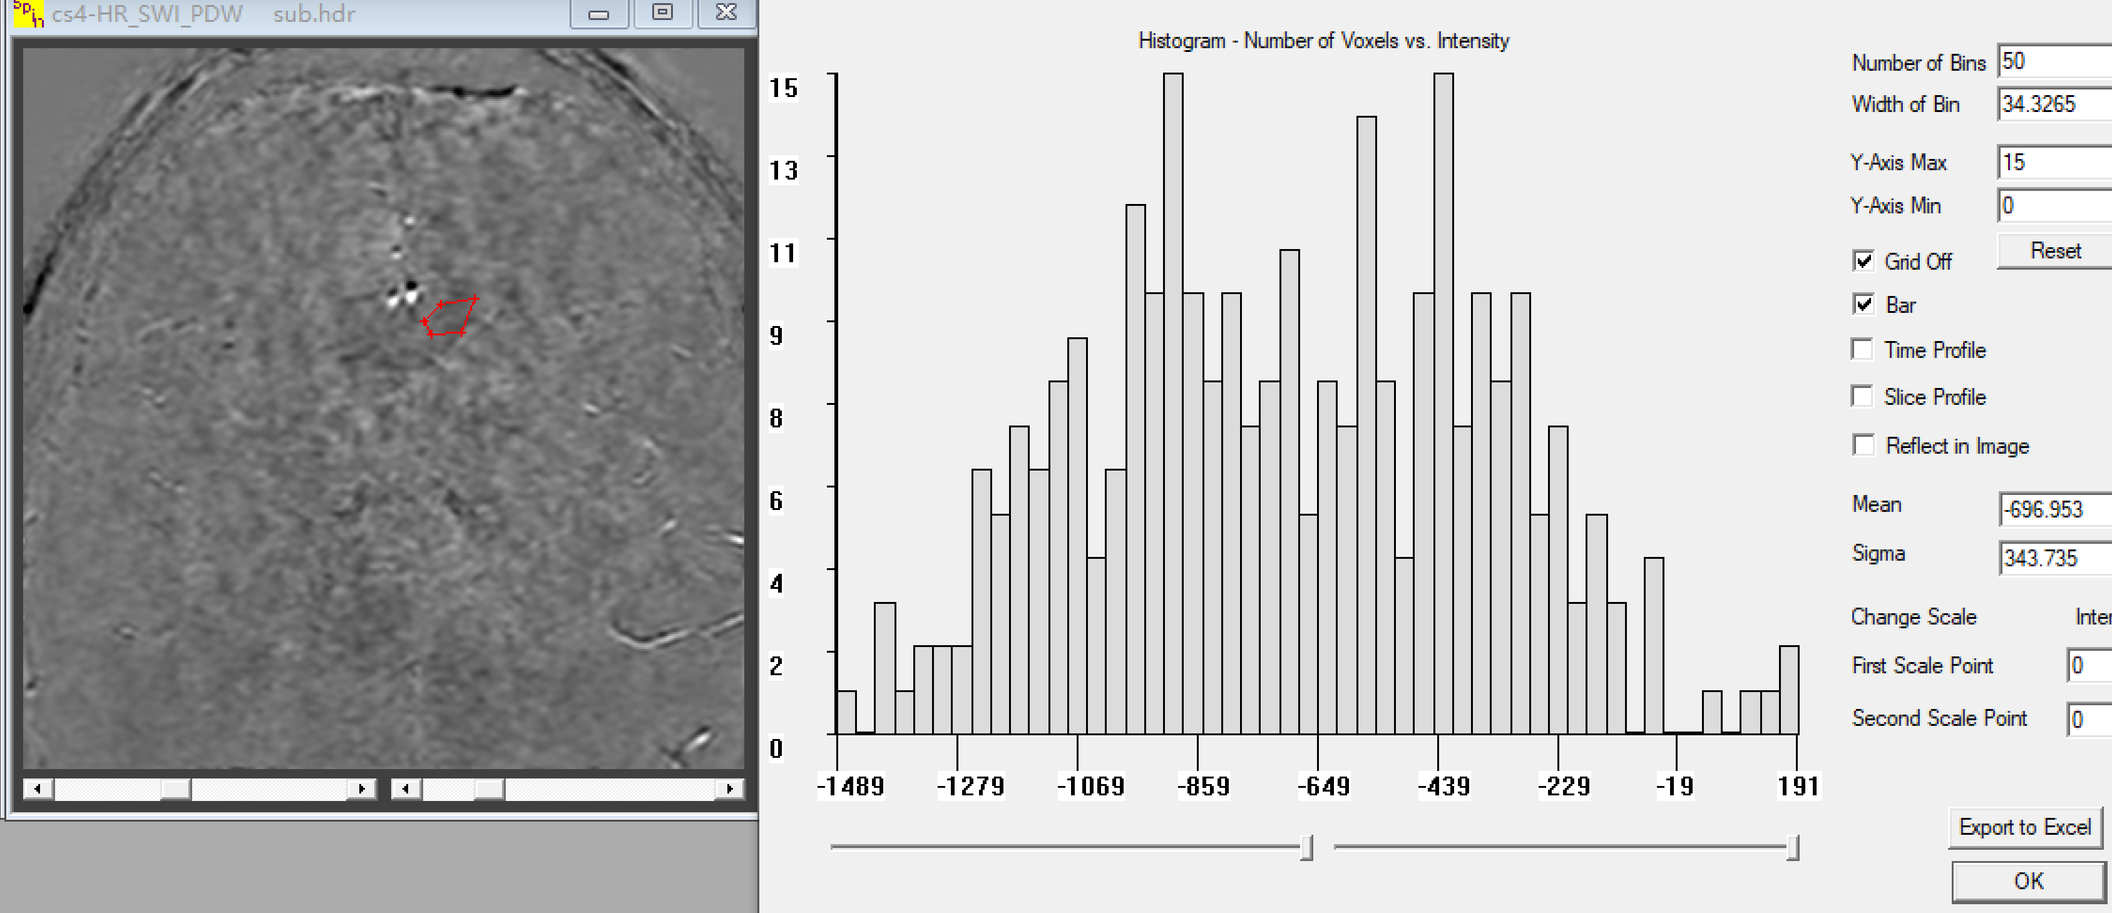
Note the boundaries are gone in the subtracted image.
Note the error here is 370 units.
Note the error here is 343 so the correct noise to quote is 343/sqrt(1.5) = 254.

Slide 9
From this Philips data we get 21,300 and 17,600 so that the Contrast = 3700
S2
S1
Note the error here is 370 units.
So you think the CNR = 10:1
Note the actual error here is actually 254.
So the correct CNR = 14.6

Slide 10
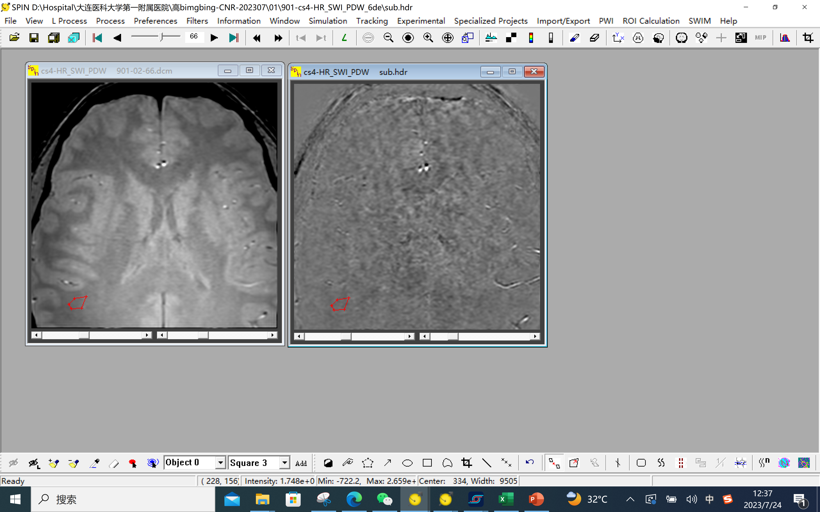
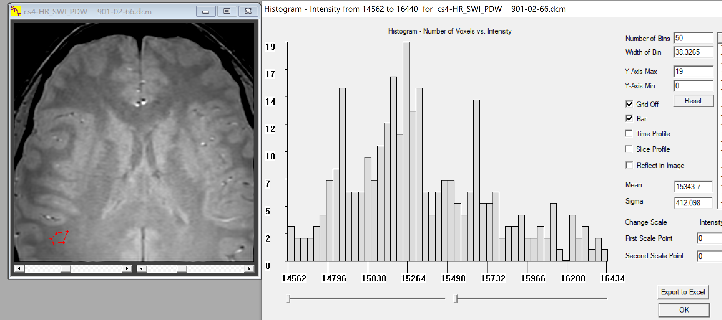
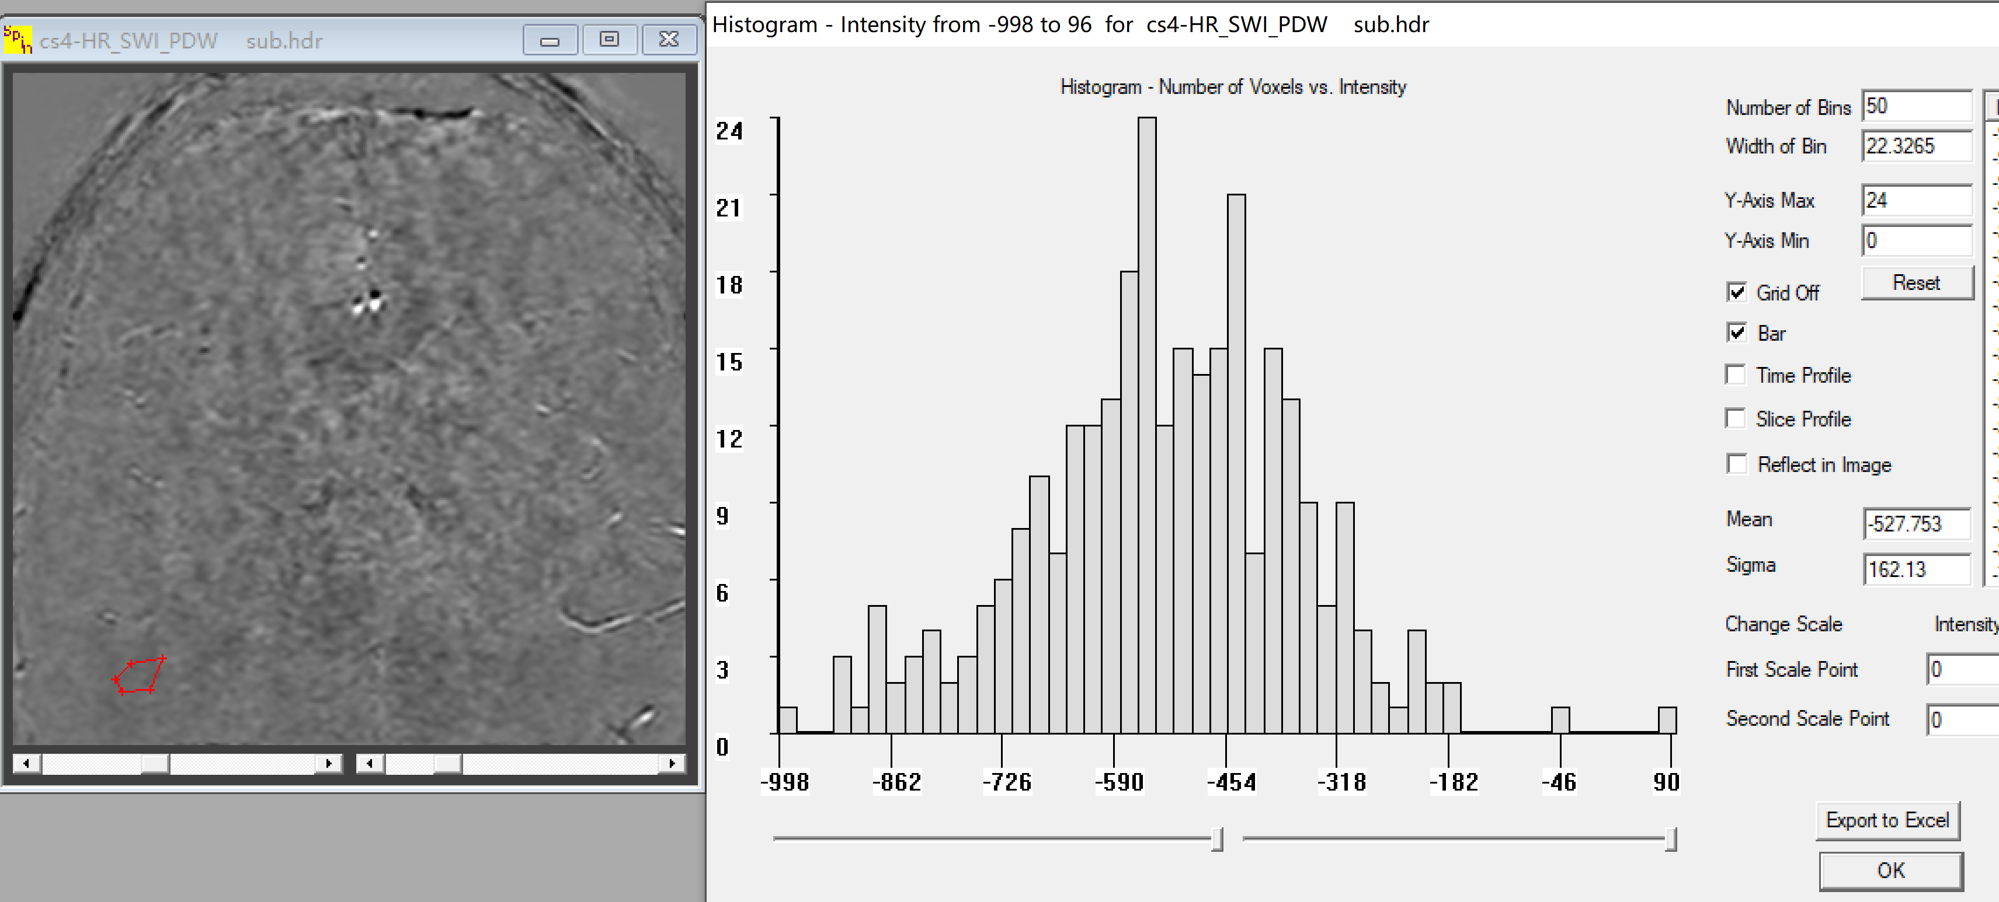
Note the boundaries are gone in the subtracted image.
Note the error here is 412 units.
Note the error here is 162 units which is sqrt(1.5) σ_{o} .
So the correct noise to quote is 162/sqrt(1.5) = 132 which is clearly much smaller than 412.

Slide 11
There are 4 ways you can find some type of contrast or contrast-to-noise measure.
1) Contrast = S1 – S2 – dangerous if the system has scaling variability – therefore plot a histogram of all your contrast measurements – if the all site in a Gaussian shape great then you can use the mean and standard deviation of contrast in your paper
2) Actual contrast-to-noise = CNR = (S1 – S2)/σ_{o} where σ_{o} is the same for all data sets.
3) Relative or normalized contrast C_{rel} = (S1-S2)/S1 – this is the best way to quote your contrast results if there are system changes from day to day
4) Alternate normalized contrast-to-noise CNR_{relalt}= (S1 – S2)/σ_{S2} – this is the worst way to get a normalized result because σ_{S2} is corrupted by background signal variations
SOLUTION
Use subtracted images from two identical data sets (or you can subtract adjacent slices and hope that the changes from slice to slice are not too large) or subtracted images from the three echo approach to obtain the best estimate of noise.

Slide 12
Noise, CNR and relative CNR:
A more in-depth discussion
E. Mark Haacke, PhD
Wayne State University
Ruijin SJTU School of Medicine

Slide 13
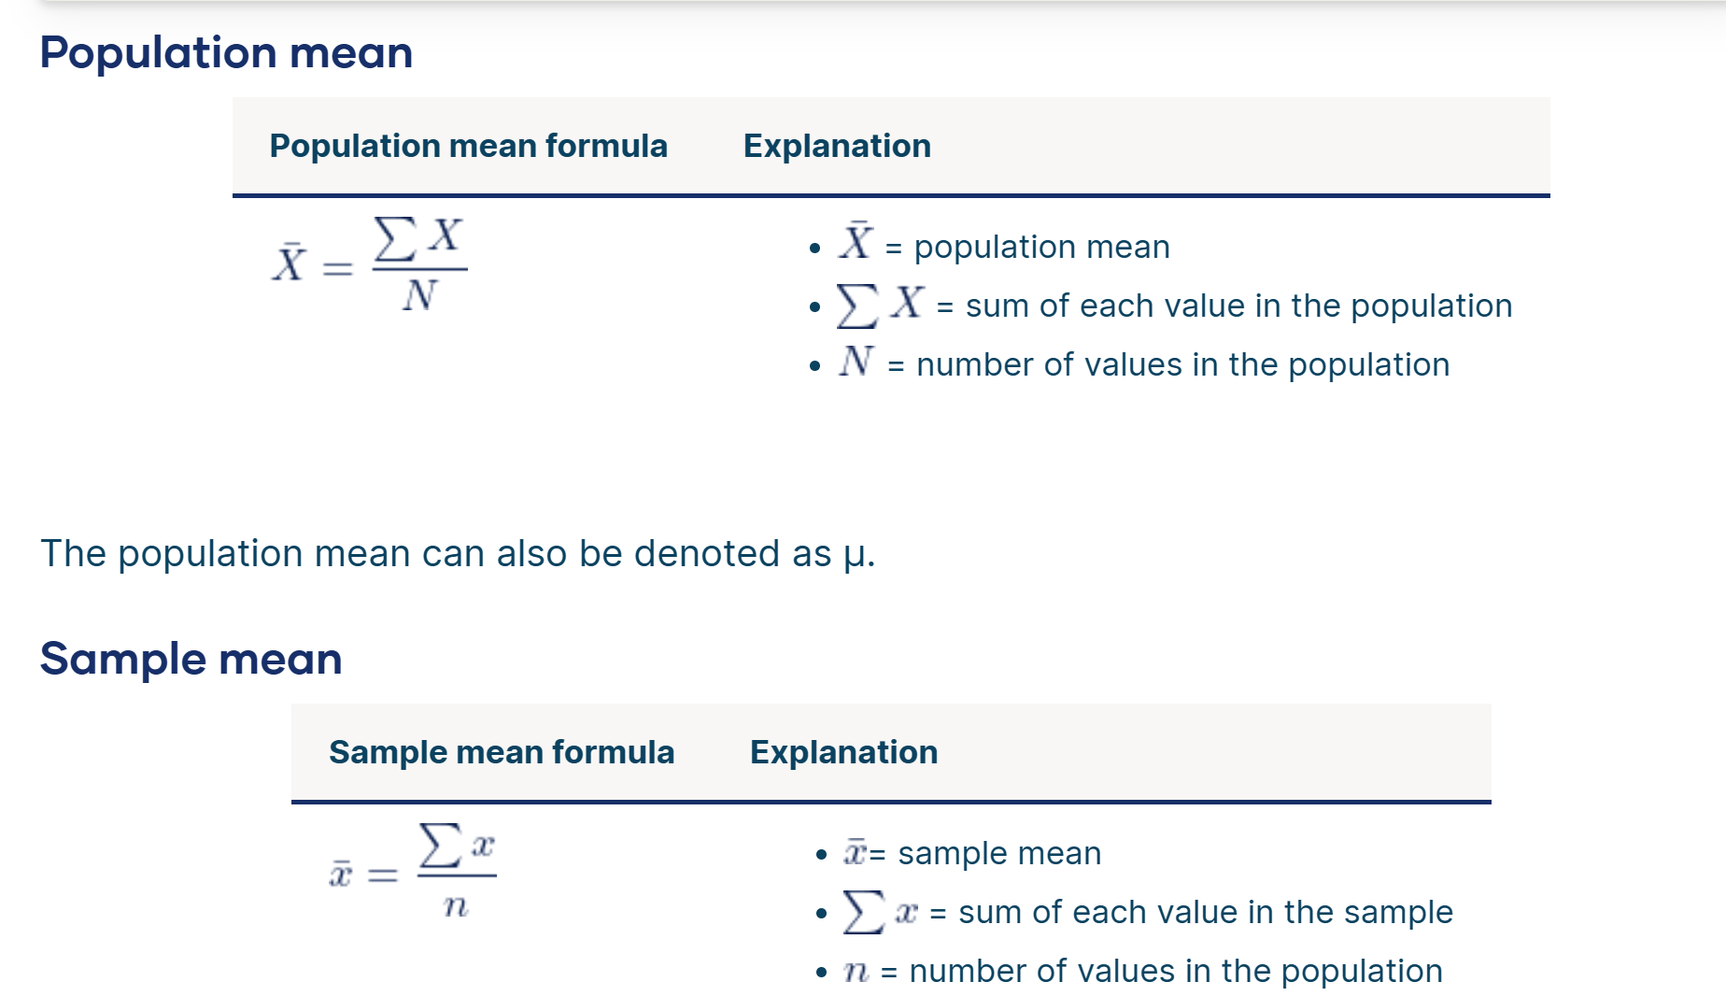
Calculating Population and Sample Mean
How to Find the Mean | Definition, Examples & Calculator (scribbr.com)

Slide 14
Calculating Population and Sample Mean
No noise
100
0
0
Remember that the mean N points x_{i} in an ROI is given by:
(1/N)Σ_{i=1,N} x_{i}
Mean = 100

Slide 15
Calculating Population and Sample Mean
No noise
110
100
90
0
0
Remember that the mean N points x_{i} in an ROI is given by:
(1/N)Σ_{i=1,N} x_{i}
Mean = 100

Slide 16
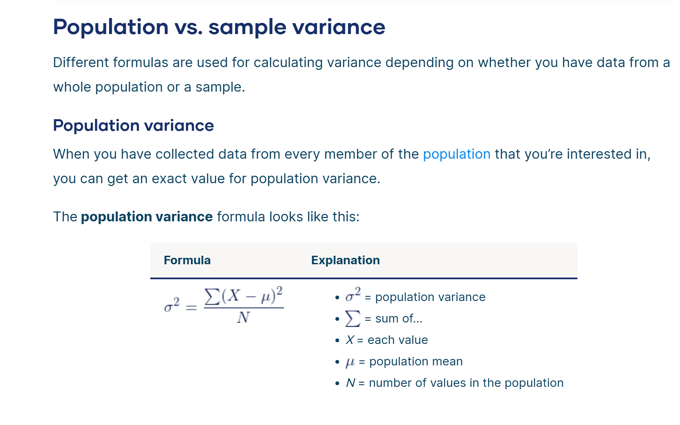
Calculating Population Variance

Slide 17
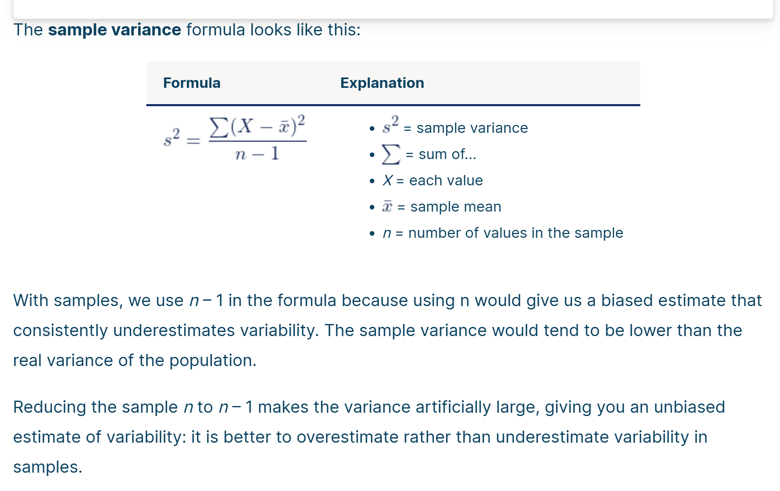
Calculating Sample Variance

Slide 18
Calculating Population and Sample Mean
With noise that is normally distributed N(100,5)
105
100
110
95
90
Variance =250 = (100+25+0+25+100)
Variance = 50
Standard deviation ≈ 7
0
0
the variance is given by:
σ² = (1/N)Σ_{i=1,N}(x_{i}-x_{avg})²
Mean = 100

Slide 19
Calculating Population and Sample Mean
With noise that is normally distributed N(100,5)
105
100
110
Mean = 100
95
90
Variance = 50
Standard deviation ≈ 7
0
0
If the backround signal is 210 then the SNR is 30:1 but if the contrast between WM and GM is 35 then the CNR is only 5:1 not so big!
The Rose criteria says that if the CNR is 5:1 or greater the contrast is easily visualized.

Slide 20
Calculating Population Variance
110
100
90
Variance =250 = (100+25+0+25+100)
Variance = 50
Standard deviation ≈ 7
0
0
Mean = 100
But wait this has no noise!
the variance is given by:
σ² = (1/N)Σ_{i=1,N}(x_{i}-x_{avg})²

Slide 21
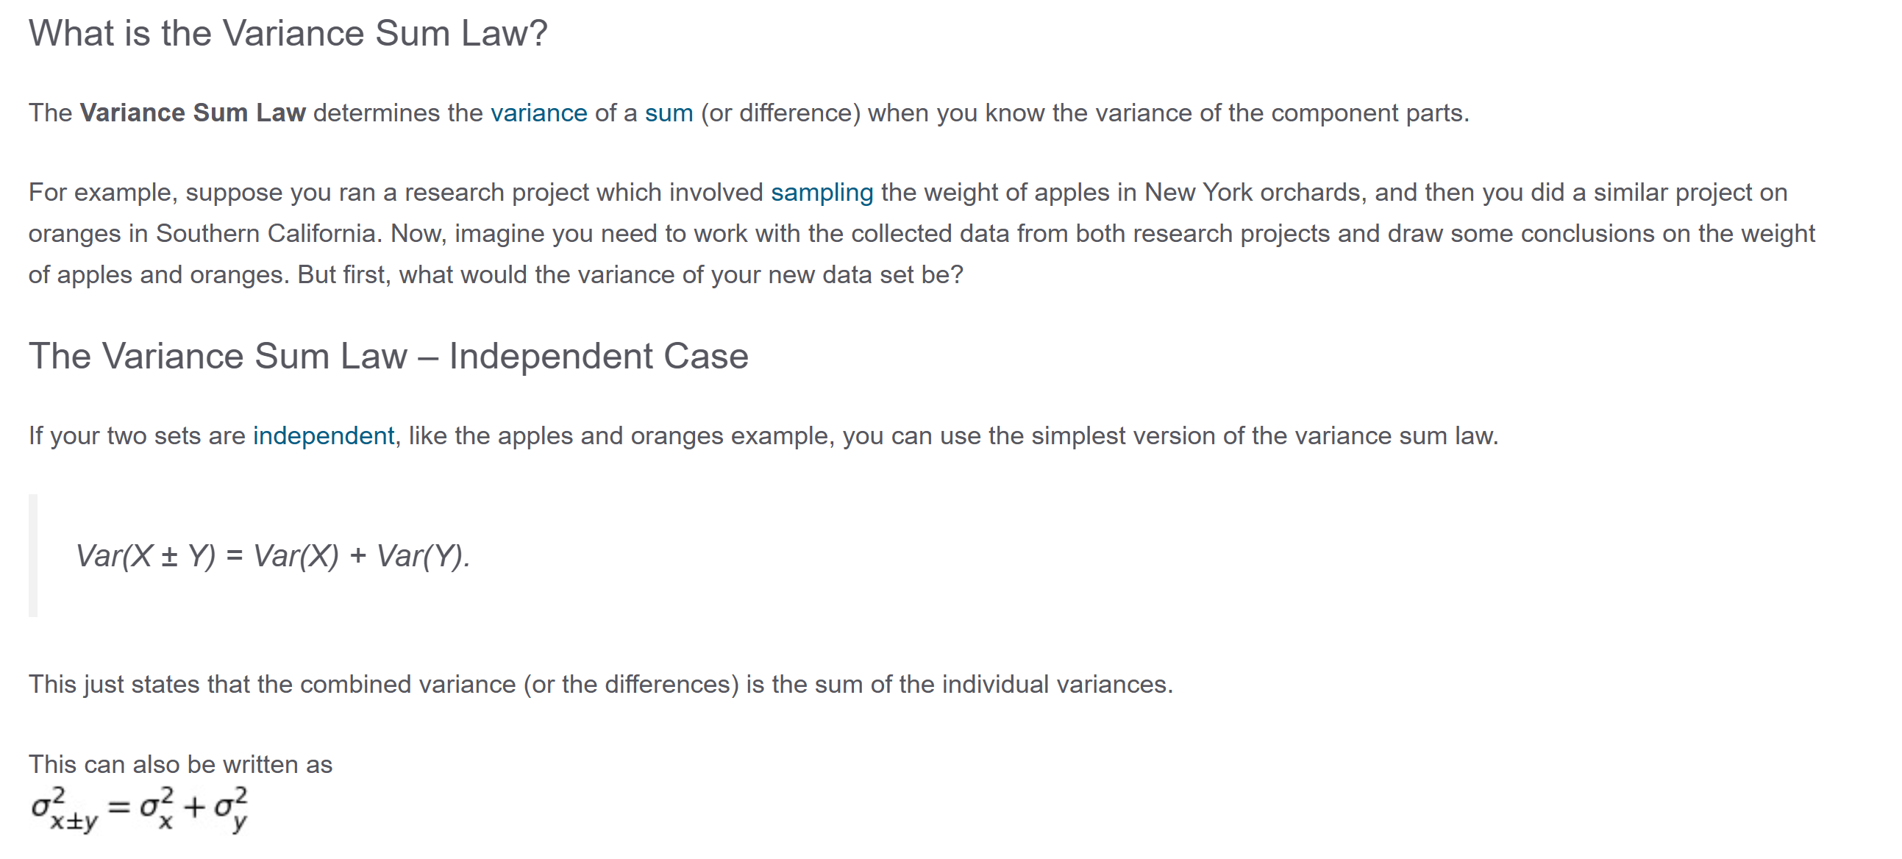
Variance sum law
Variance Sum Law: Determining a Variance of a Sum from the Parts (statisticshowto.com)

Slide 22
Variance sum law
Z = X – Y
variance(Z) = variance(X) + variance(Y)
If variance of X = variance Y = σ_{o}² then
variance(Z) = 2 σ_{o}²
and
standard deviation (Z) = σ_{Z} ≈ sqrt(2) σ_{o} therefore
σ_{o} = σ_{Z}/sqrt(2)
The standard deviation is given by:
σ = sqrt[variance]
= sqrt[(1/N)Σ_{i=1,N}(x_{i}-x_{avg})²]

Slide 23
Understanding how to calculate noise
Noise on the left at the edge of the brain is 8.6 units and noise for the middle part of the brain is 18.8 more than double the noise at the edge (due to parallel imaging reconstruction properties) and distance from the coils. Note also as expected that the average zero!

Slide 24
Understanding how to calculate noise
If you only have one echo, then you can subtract two adjacent slices and look for regions where the mean noise is zero (that is, the signal stayed the same from slice to slice).

Slide 25
Noise, CNR and relative CNR:
Now that you have found the noise, do you measure noise for each case?
Well, you can, and then create a histogram of all standard deviations and take the mean of all these estimates (even though that may still be somewhat biased).
But as we will see to find CNR = (S1 – S2)/σ_{o}
You should validate that all the noises are the same (which for the same sequence and head coil they should be) and then just use one value!

Slide 26
There are 4 ways you can consider calculating some type of contrast or contrast-to-noise measure.
1) Contrast = S1 – S2
2) Actual contrast-to-noise = CNR = (S1 – S2)/σ_{o}
The challenge is finding the standard deviation in an image. To do this you need to find an absolutely uniform region in the image. You can assess this by plotting the profile and if it is constant across the ROI you are using then you can use the measured standard deviation σ_{m} in the above formula. Otherwise, if the ROI has some spatial variation in its signal that will induce a structural standard deviation σ_{s} which corrupts your measurement.
In that case, your total measured standard deviation will be σ_{m} which actually represents contributions from the actual white noise and the structural standard deviation as follows:
σ_{m}² = σ_{s}² + σ_{o}²
One thing to always remember is the Rose criteria that says you need a CNR of roughly 4:1 to see something in an image. If you are getting CNR measures of 1 or 0.5 clearly you did something wrong in the process. Your CNR values should be more > 5 usually.

Slide 27
There are 4 ways you can consider calculating some type of contrast measure.
3) Relative contrast C_{rel} = (S1-S2)/S1
What if for one person we have the correct (S1, S2), but for the next person we have (2S1, 2S2)
Then your contrast will appear to double! But for relative contrast the result remains the same:
C_{rel} = (2S1 - 2S2)/2S2
= (S1 - S2)/S2
In fact, if S1’=aS1 and S2’=aS2 then
C_{rel} = (S1’ - S2’)/2S2’
= (aS1 - aS2)/2aS2
= (S1-S2)/S2
So, we say that Crel is scale invariant.

Slide 28
There are 4 ways you can consider calculating some type of contrast measure.
4) Alternate normalized contrast-to-noise CNR_{relalt}= (S1 – S2)/σ_{S2}
Actually, σ_{S2} theoretically is just a constant (1/b) times S2, that is S2/b.
This σ_{S2} is difficult to measure even if there are no background structures, but very bad to use if there are background structural variations. That’s because the term σ_{s} can dominate the result giving basically the same high result for each image almost independent of the real noise σ_{o}.
However, if you can really measure σ_{o} accurately without structural variation then we can ask:
“How does this relate to the more robust method of C_{rel}?
C_{relalt} = (S1 - S2)/σ_{S2}
= b(S1 - S2)/S2
= bCNR_{rel}
In the end, it is much better just to use CNR_{rel} where S2 is much easier to measure and does not have this same level of problem with structural variation.

Slide 29

How then do we measure noise?
One way is to acquire the data twice, then subtract: ΔS = S11 – S12 , then σ_{ΔS}= sqrt(2) σ_{o}
But if you did not collect the data twice, then what?
Well, if you are using PDIC data then you are lucky because you can average TE1 and TE3 then subtract the signal from TE2 that is take 0.5(S(TE1) + S(TE3)) – S(TE2)= ΔS.
What is the variance of this operation of ΔS where
ΔS = Savg(TE1,TE2,TE3) – S(TE2)
= 1/3(S(TE1) + S(TE2) + S(TE3)) – S(TE2)
Variance ΔS = (1/9 + 4/9 + 1/9) σ_{o} = 2/3 σ_{o}

Slide 30
How then do we measure noise?
Well, if you are using PDIC with the three echoes being 7.5ms, 15ms, and 22.5ms, then
That is, we expect ΔS = S(TE2)-avgS(TE1,TE3)=0.
Therefore,
σ_{ΔS}² = 1.5σ_{o}² so finally σ_{ΔS} = sqrt(1.5)σ_{o}
and therefore
σ_{o} = σ_{ΔS} /sqrt(1.5)
Now you can calculate the correct noise σ_{o} and use it for the CNR calculation. However, remember that this is only true if there are no scale variations from scan to scan.

Slide 31
Conclusion
Finally, you should always plot your results for both:
contrast
C = (S1-S2)
and relative contrast
C_{rel} = (S1- S2)/S2.
You can also find the noise as described above and plot
CNR (S1 – S2)/σ_{o}

