Slide 1
MAGNETIC RESONANCE IMAGING:
SEMPER INCITARE
E. Mark Haacke, Ph.D.
Wayne State University
Detroit, Michigan, USA
Ruijing Hospital, SJTU
Shanghai, China

Slide 2
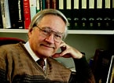
The Excitement of MRI
Richard Ernst summarized the excitement and future potential of MRI in his 1991 Nobel Prize acceptance speech:
“I’m not aware of any other field of science outside of magnetic resonance that offers so much freedom and opportunity for a creative mind to invent and explore new experimental schemes that can be fruitfully applied in a variety of disciplines.”
The incredible flexibility of MRI is due to the fact that many if not most of the new developments can build on top of the current technology making it more and more powerful.
For example, a sequence can have: multiple echoes, shared k-space, partial Fourier, elliptical sampling, flow compensation gradients, parallel imaging or compressed sensing, diffusion or flow encoding gradients, be interleaved doubling the number of modifications that can be made, etc., etc., etc.

Slide 3
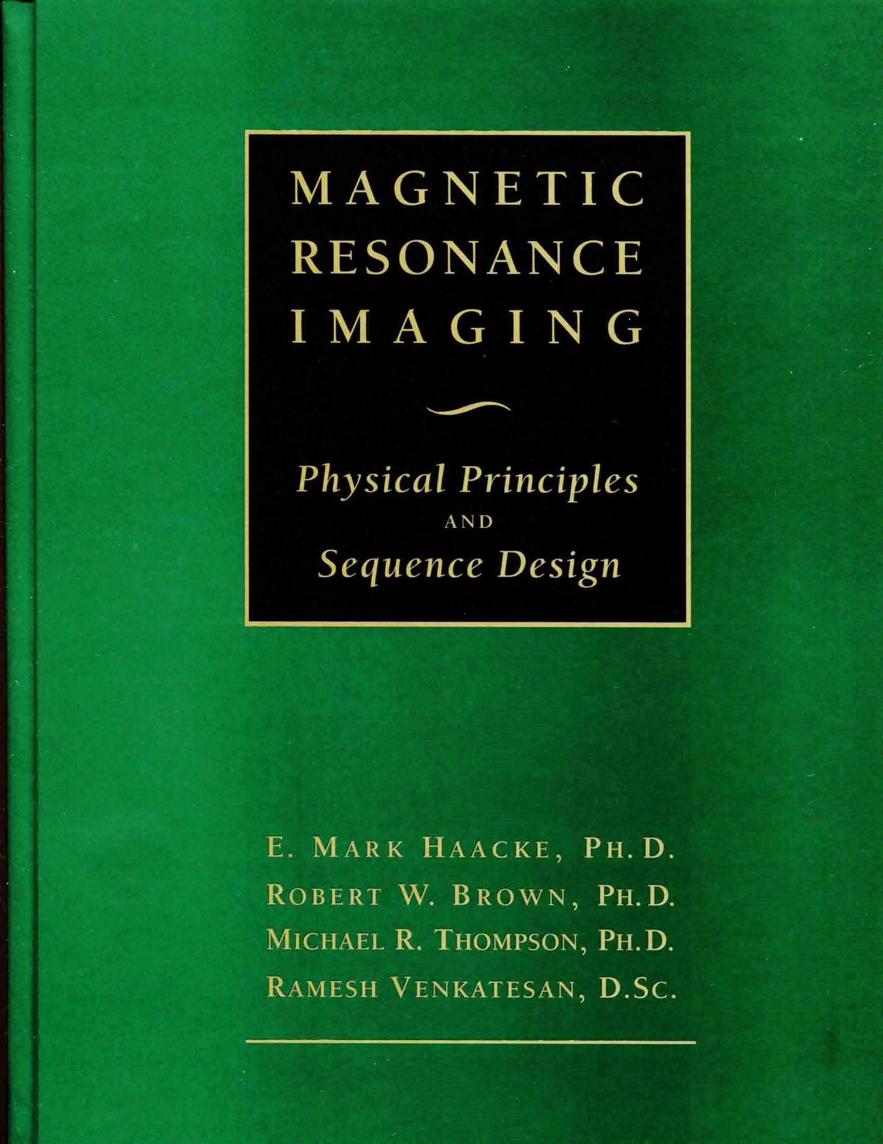
Education: A labor of Love
“It’s easy to show that …”
Create a text that carries the student step by step through the basic to advanced concepts without once using that phrase!
The result of this 28 man-year effort was “The Green Bible of MRI”.

Slide 4
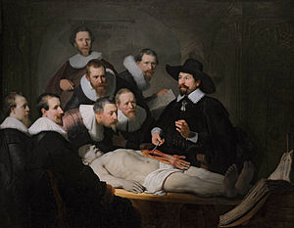
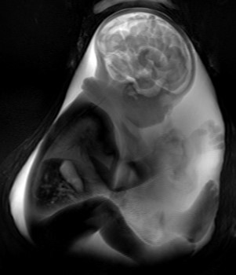
The Anatomy Lesson of Dr. Nicolaes Tulp: Rembrandt 1632
A budding mathematician
counting his fingers.
In the old days, we cut open the human body from the outside in. Now we look at the body from the inside out.

Slide 5
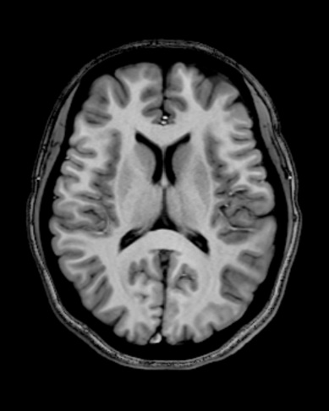
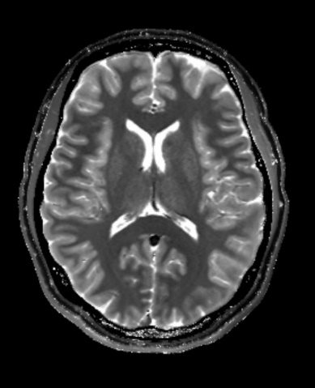
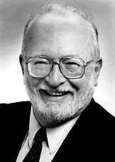
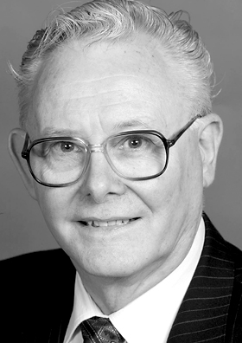
Visualizing Quantum Mechanics
Lauterbur
Thin slice T1 and T2 weighted 3D images of the brain. Nobel prize in Medicine or Physiology 2003.
Mansfield

Slide 6
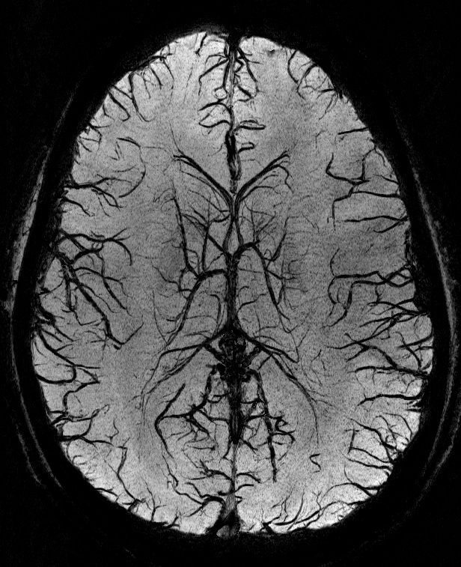
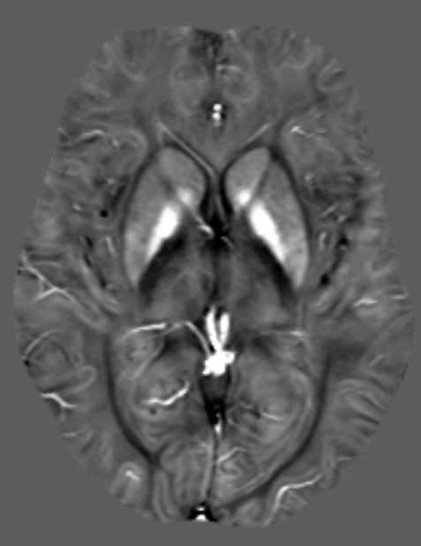
Nearly everything you need to know about MRI is buried in the phase information.
E. Mark Haacke, PhD
Wayne State University
Ruijin Hospital, SJTU

Slide 7
Fundamentals
Basics of gradient-echo signal formation
Phase and its fundamental role in imaging
Phase as a source of T₂* dephasing
Background phase/field removal

Slide 8
Applications
Water/fat separation
Flow quantification
Temperature mapping
Susceptibility weighted imaging (SWI)
Quantitative susceptibility mapping (QSM)
Measuring and visualizing conductivity

Slide 9
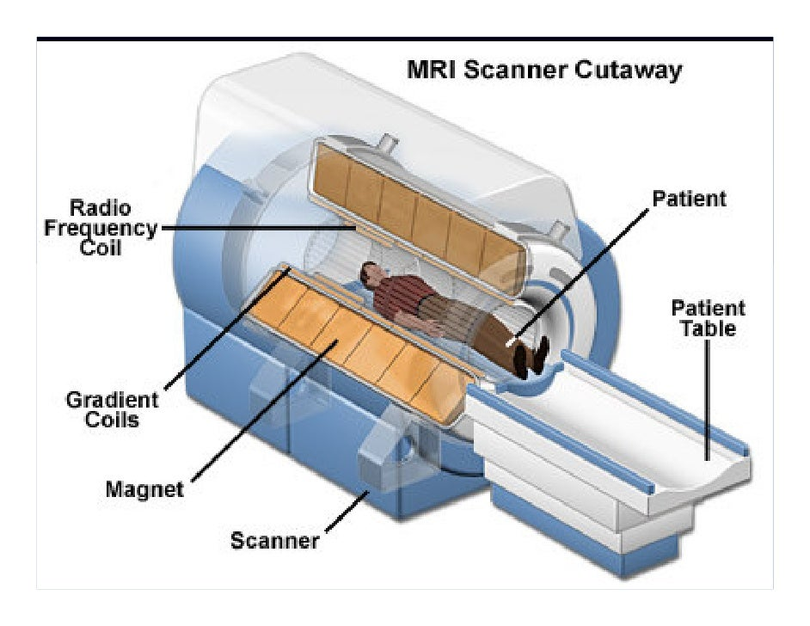
Very basics of the MR scanner
schematic of MR scanner parts - Search

Slide 10
Magnetic Resonance Imaging
Although quantum physics was needed to formulate the theoretical concepts and explain the experimental design and results in magnetic resonance, the final impact rests on the very simple relationship given by the well known Larmor equation relating the frequency of rotation or precession frequency (ω) and the local magnetic field (B) via ω = γB.
Larmor equation: ω = γB
In vector notation: ω = −γB

Slide 11

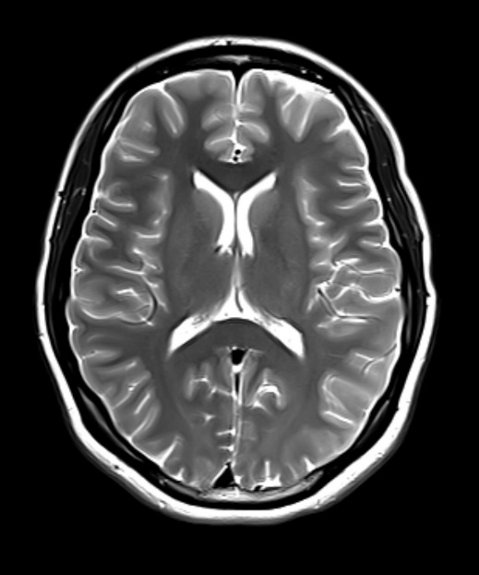
Visualizing Quantum Mechanics
Thin slice T1 weighted and thick slice T2W images

Slide 12
Basic MRI concepts
ω = −γΒ
B: the applied magnetic field
γ : the gyromagnetic ratio of the proton γ
ω: the magnetic resonance
frequency

Slide 13
What happens when an object is inside the magnet?
B_{o}z
z
A cylindrical object in a constant magnetic field.
Its bulk magnetization lies parallel to the main field.
M₀
0
y
x
A simple sequence diagram showing no application of rf or gradient fields and hence no signal.
rf
t
G
Signal

Slide 14
What happens after we apply an oscillating rf field?
z
B_{o}z
Applying an oscillating radiofrequency (rf) field along the x-axis rotates M₀ from the z-axis into the transverse plane so that it lies along the y-axis.
M₀
y
Beff
M₀
x
At this time, the rf field is turned off and the transverse magnetization precesses about the main field B₀.

Slide 15
MR Signal Readout
The precessing transverse component induces a voltage in a coil which is placed so that it sees a changing magnetic flux.

Slide 16
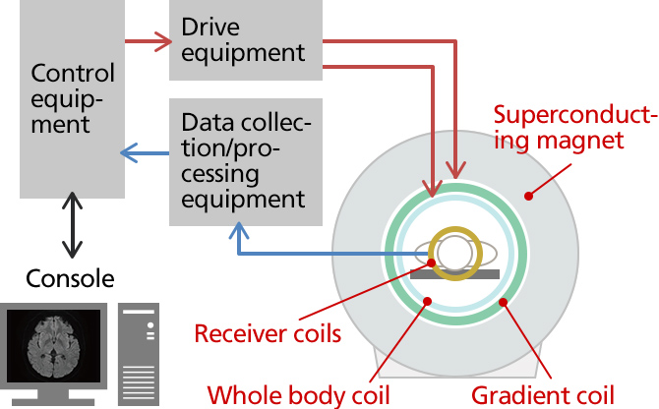
From magnet to console

Slide 17
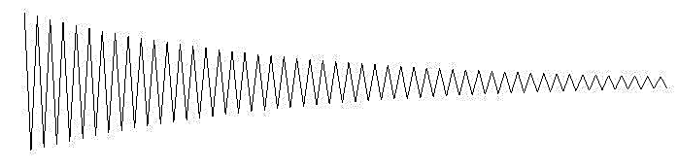
What happens after we apply an oscillating rf field?
z
B_{o}z
Applying an oscillating radiofrequency (rf) field along the x-axis rotates M₀ from the z-axis into the transverse plane so that it lies along the y-axis.
Sequence diagram
M₀
y
Beff
M₀
x
rf
t
G
Signal

Slide 18
Gradient Echoes and
1D Imaging
B_{z}(x)
ρ(x)
0
x
x

Slide 19

The Larmor equation
$$ω=−γB$$
$$φ=ωt$$
$$φ=−γBt$$
  Right-handed system
  γ: gyromagnetic ratio.
  For hydrogen,
  γ = γ/2π=42.576 MHz/T

Slide 20

Jump into the rotating reference frame
$$ω\text{rot}=−γ(B−Bo)$$
$$ω\text{rot}=−γΔB$$
$\text{f}\text{r}\text{ot}$ = $−$γ $ΔB$
$$φ=ωt$$
$$φ=−γΔBt$$

Slide 21
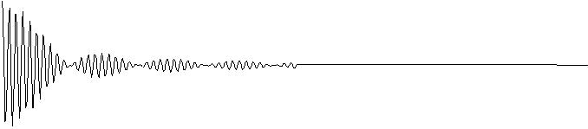
Adding a magnetic field gradient to encode spins.
B₀
z
By purposely adding a gradient field G, we can spatially distinguish the spins by their frequency content since now
(x) = γ (B₀ + G_{x}x)
_{rot}(x) = γG_{x}x
ΔB = G_{x}x
B_{z}
y
z
0
x
ΔB_{z}(x)= -G_{z}x
rf
t
t₁
t₂
G_{x}
Signal

Slide 22
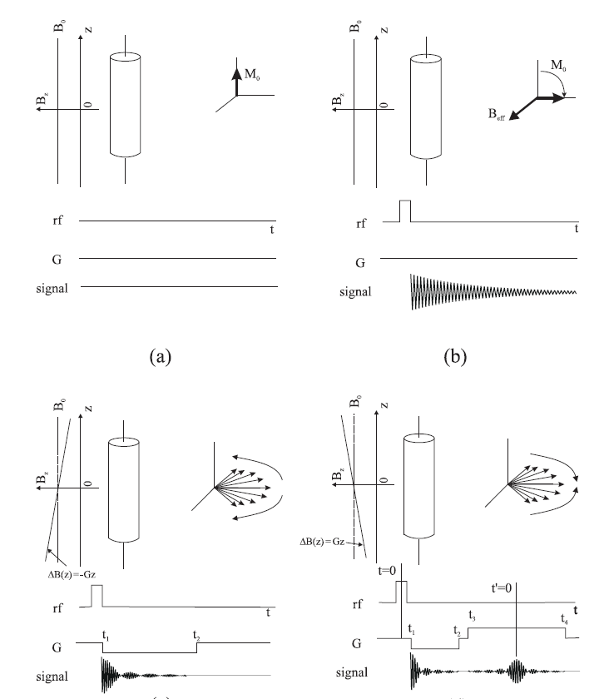
Adding a magnetic field gradient to encode spins.
B₀
z
B_{z}
y
Applying a dephasing gradient followed by a rephasing gradient causes the spins to first run away from each other and then to turn around and run back creating a gradient echo.
z
0
x
ΔB_{x}(x)= G_{x}x
rf
t
t₂
t₁
G_{x}
Signal
TE
Notes:
Slide 18

Slide 23
B_{z}(x)
ρ(x)
0
x
x
(x) = γG_{x}x

Slide 24
Adding a magnetic field gradient to encode spins.
B₀
B_{z}(x)
B_{z}
ρ(x)
Applying a dephasing gradient followed by a rephasing gradient causes the spins to first run away from each other and then to turn around and run back creating a gradient echo.
_{x}
0
0
x
x
ΔB_{z}(x)= G_{x}x
rf
t
t₂
t₃
t₁
G_{x}
Signal
TE
Notes:
Slide 18

Slide 25



The MR Signal as a Fourier Transform
$$s\left(t\right)=\int{dxρ\left(x\right)e^{−iγGxt}⁡}$$
z
where ρ(x) is the spin density and using k = γGt as the spatial frequency we find
y
x
$$s\left(k\right)=\int{dxρ\left(x\right)e^{−i2πkx}⁡}$$
the spin density can be reconstructed as
y
$$ρ(x)=\int{dks\left(k\right)e^{i2πkx}⁡}$$
x

Slide 26
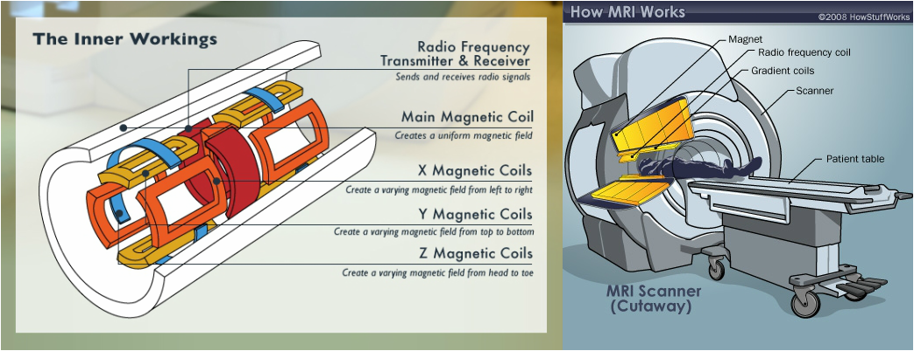
Gradient coil components

Slide 27



Phase Evolution
Phase is the integral of precession frequency (or field strength) over time
$$φ\left(t\right)=\int{dt}ω(t)$$
Gradients
Susceptibility Induced Fields
Eddy Currents
Main Field Inhomogeneities
Molecular Environment (Chemical Shift)
$$ω=γΔB_{z}$$
$$φ\left(t\right)=γ\int{dt}ΔB_{z}(t)$$

Slide 28
Phase from a Gradient-echo Signal
The complex MRI signal has both real and imaginary components or magnitude and phase components
φ(TE) = γΔB∙TE+φ_{0,} for a left-handed system.
¹Magnitude Image
Phase Image
¹Data were acquired using 3D gradient-echo sequence with full flow compensation (SWI sequence).

Slide 29

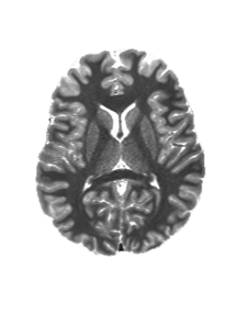
Insight comes with knowledge
The more you read, the more you discuss, the more you practice, the more you teach, the more insight you will gain.
Sometimes this insight will lead to inspiration, which can come when you least expect it, like waking up in the morning, or taking a long philosophical walk in a beautiful Suzhou garden.

Slide 30
Pause

